Slide 1
งานวิจัยสังคมศาสตร์ ในมิติของคุณภาพชีวิตและความยั่งยืน
The Social Science research in the area of Quality of life and Sustainability
อาจารย์ ดร.โอม โตอาจ และ อาจารย์ ดร.สรประเวศ กระจ่างคันถมาตร์
Faculty of Social Sciences and Humanities, Mahidol University
21 ธันวาคม 2567 9.00-12.00 น.

Slide 2
Contents
Introduction to Quality of Life and Sustainability
1. Environmental Sustainability Clean Air and Water Healthy Ecosystems Climate Change Mitigation
2. Social Sustainability Equity and Inclusion Community Well-being Cultural Diversity
Half-time break
3. Economic Sustainability Sustainable Consumption Green Jobs Fair Trade
Q&A and Closing Remarks

Slide 3
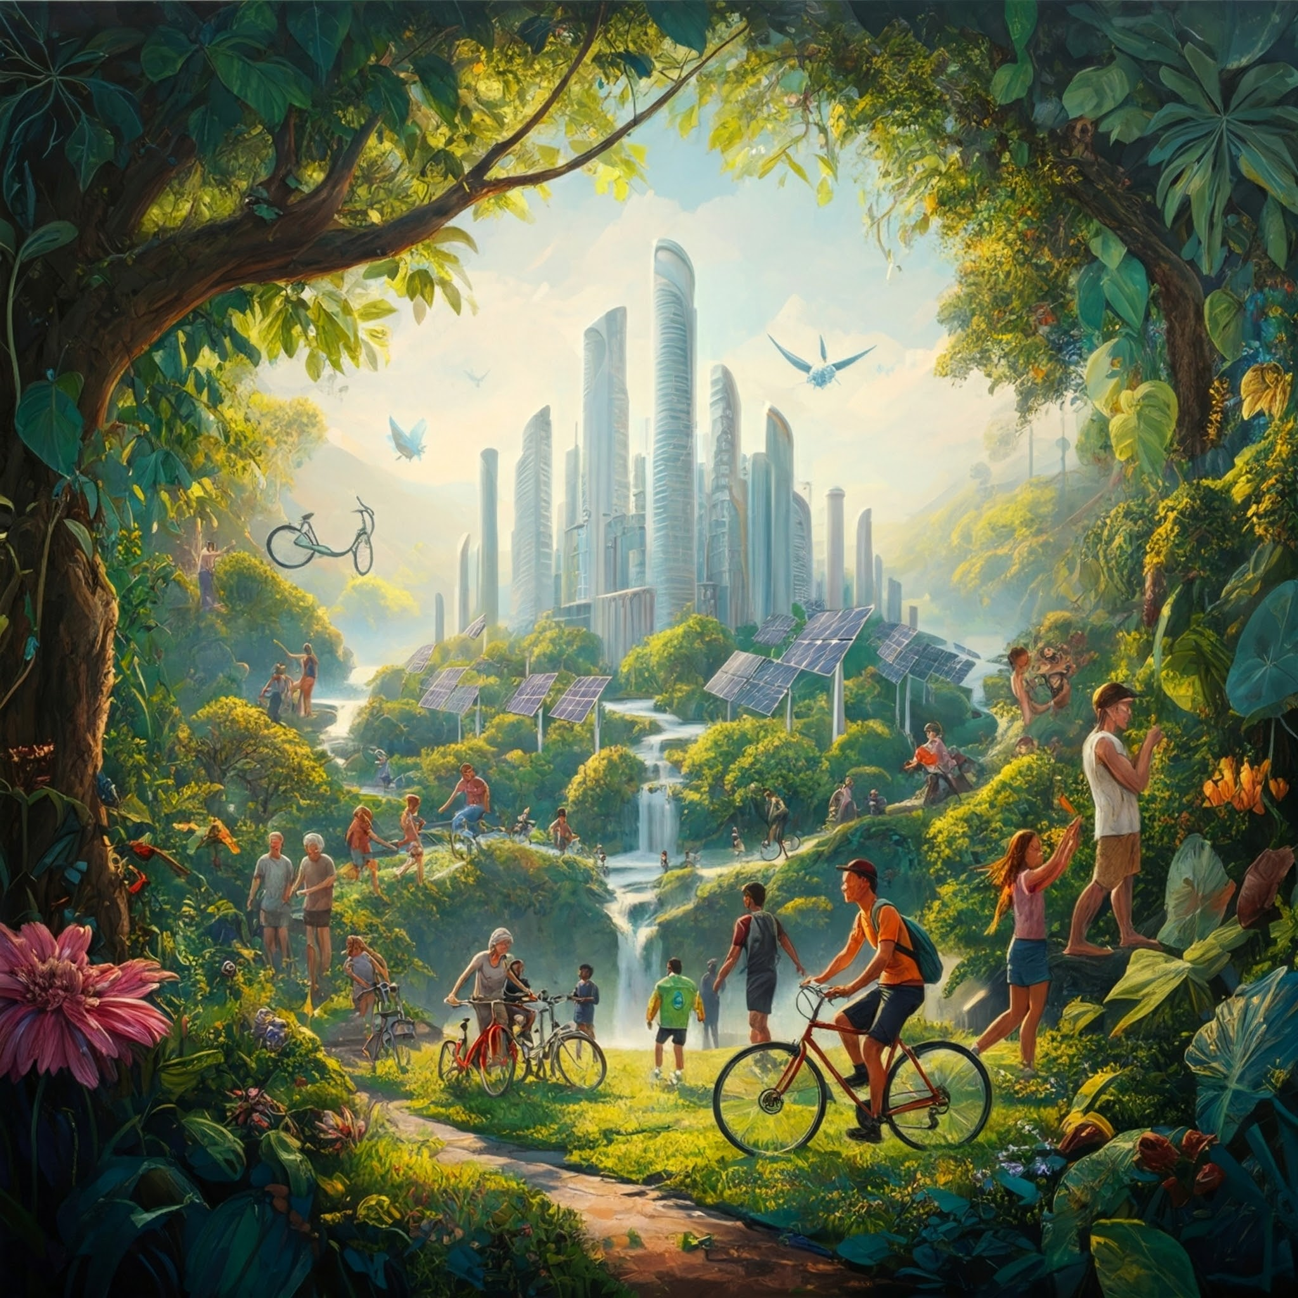
Quality of Life and Sustainability

Slide 4
Introduction to Quality of Life and Sustainability: An Economic, Social, and Environmental Perspective
Key Points to Cover:
Defining Quality of Life:
  A multidimensional concept encompassing physical, mental, and social well-being.
  The role of economic, social, and environmental factors in shaping quality of life.
Interconnections between the Three Pillars:
  How economic, social, and environmental factors are interconnected.
  The importance of a balanced approach to achieving sustainable development.
  The role of policy and governance in promoting sustainable development.

Slide 5
Sustainable Development

Slide 6
1987 : Our Common Future Report (Brundtland Report)
sustainable development was defined establishing links between social, economic, cultural and environment issues.
Economic
Social
Sustainable
Development
Environment

Slide 7
Sustainable development goals (SDGs)

Slide 8
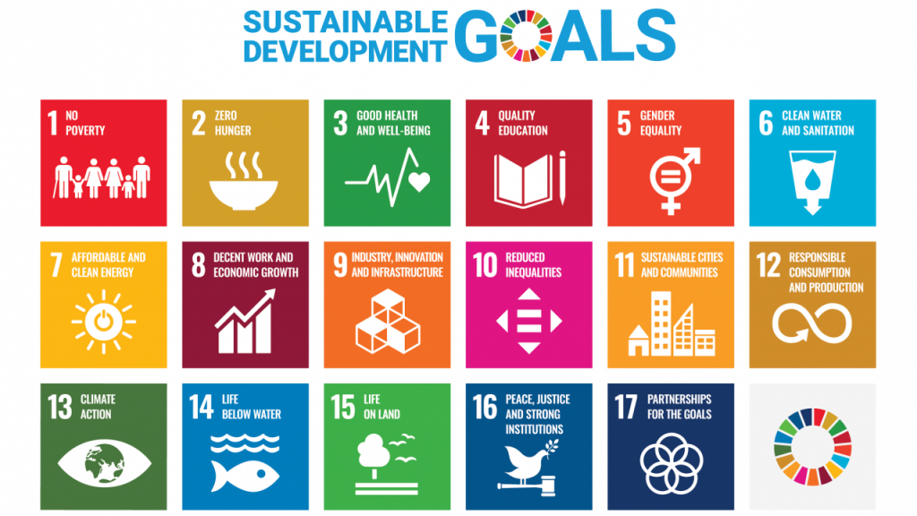

Slide 9
Sustainable development goals: a bibliometric analysis of literature reviews
Yamaguchi, N. U., Bernardino, E. G., Ferreira, M. E. C., de Lima, B. P., Pascotini, M. R., & Yamaguchi, M. U. (2023). Sustainable development goals: a bibliometric analysis of literature reviews. Environmental Science and Pollution Research, 30(3), 5502-5515.

Slide 10
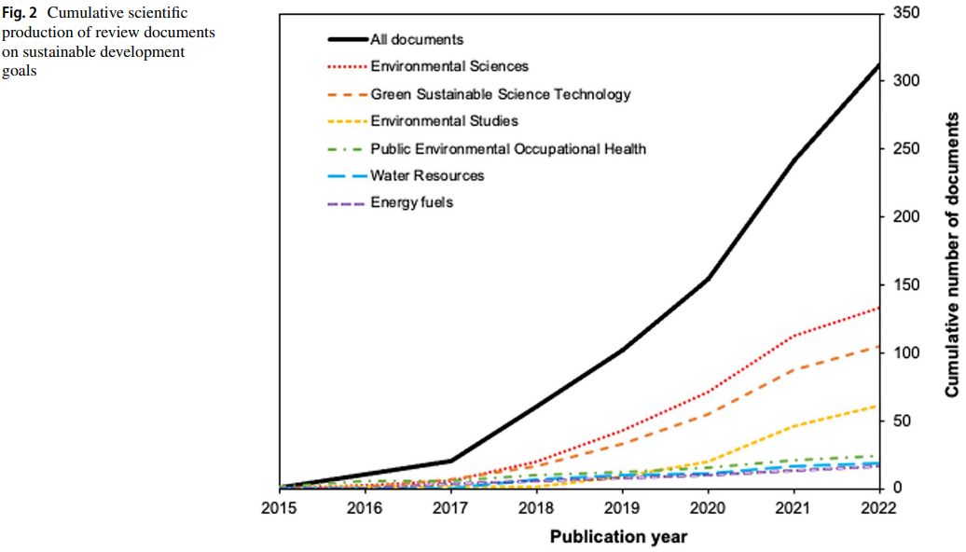
total of 312 publications
Research areas
Source: Yamaguchi et al., 2023.

Slide 11
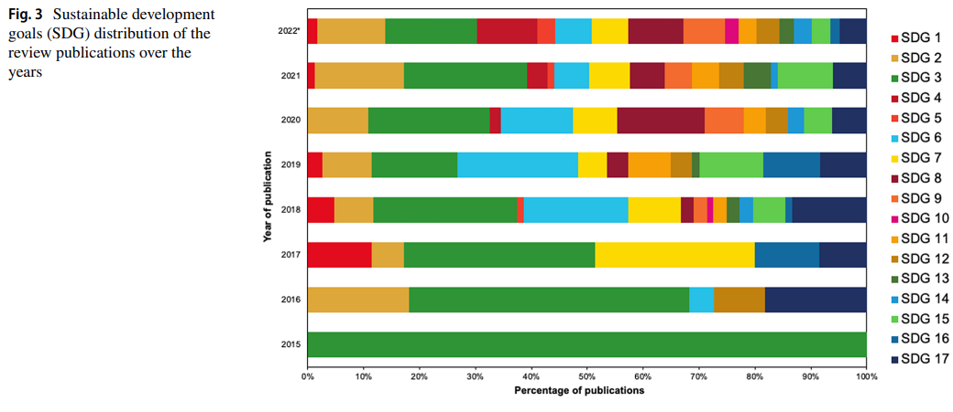
Source: Yamaguchi et al., 2023.

Slide 12
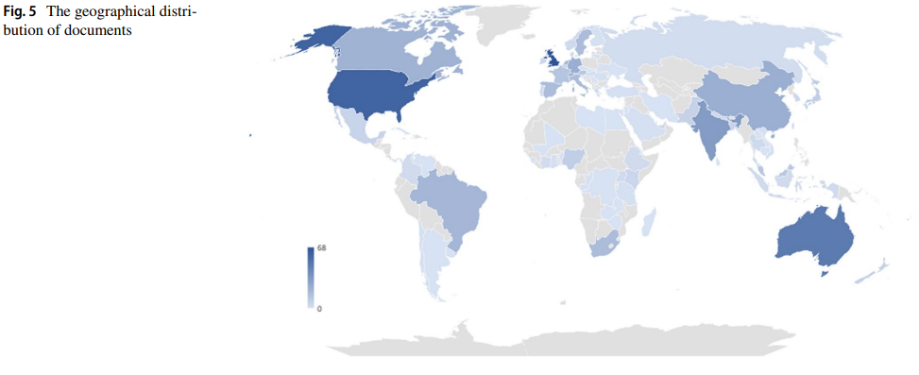
Source: Yamaguchi et al., 2023.

Slide 13
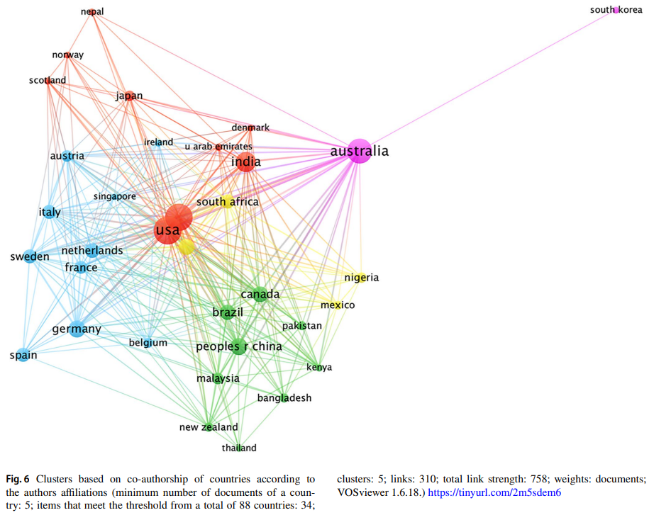
Co-authorship
Source: Yamaguchi et al., 2023.

Slide 14
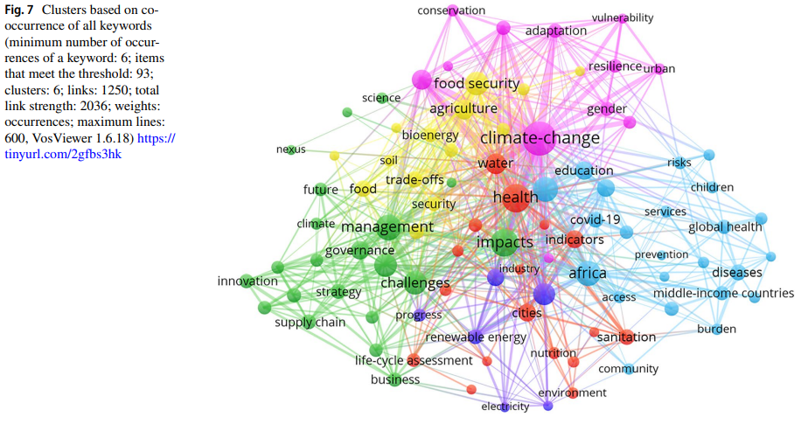
Keywords
Source: Yamaguchi et al., 2023.

Slide 15
Conclusions
ประเทศอังกฤษ สหรัฐอเมริกา และออสเตรเลีย เป็นประเทศที่มีผลงานวิจัยด้าน SDG มากที่สุด อย่างไรก็ตาม ประเทศที่มีความร่วมมือระหว่างทวีปและมีความร่วมมือกับประเทศกำลังพัฒนาแสดงให้เห็นถึงความเกี่ยวข้องที่มากขึ้น
Keyword ที่พบบ่อยที่สุด คือ สุขภาพ (SDG 3), การเปลี่ยนแปลงสภาพภูมิอากาศ (SDG 13), อาหาร (SDG 2), พลังงาน (SDG 7) และน้ำ (SDG 6)
ยังมี Gap of Knowledge เกี่ยวกับการลดความเหลื่อมล้ำ (SDG 10), ความเท่าเทียมทางเพศ (SDG 5), มหาสมุทร ทะเล และสิ่งแวดล้อมทางทะเล (SDG 14) และที่เกี่ยวข้องกับสันติภาพ ความยุติธรรม และสถาบันที่เข้มแข็ง (SDG 16)

Slide 16
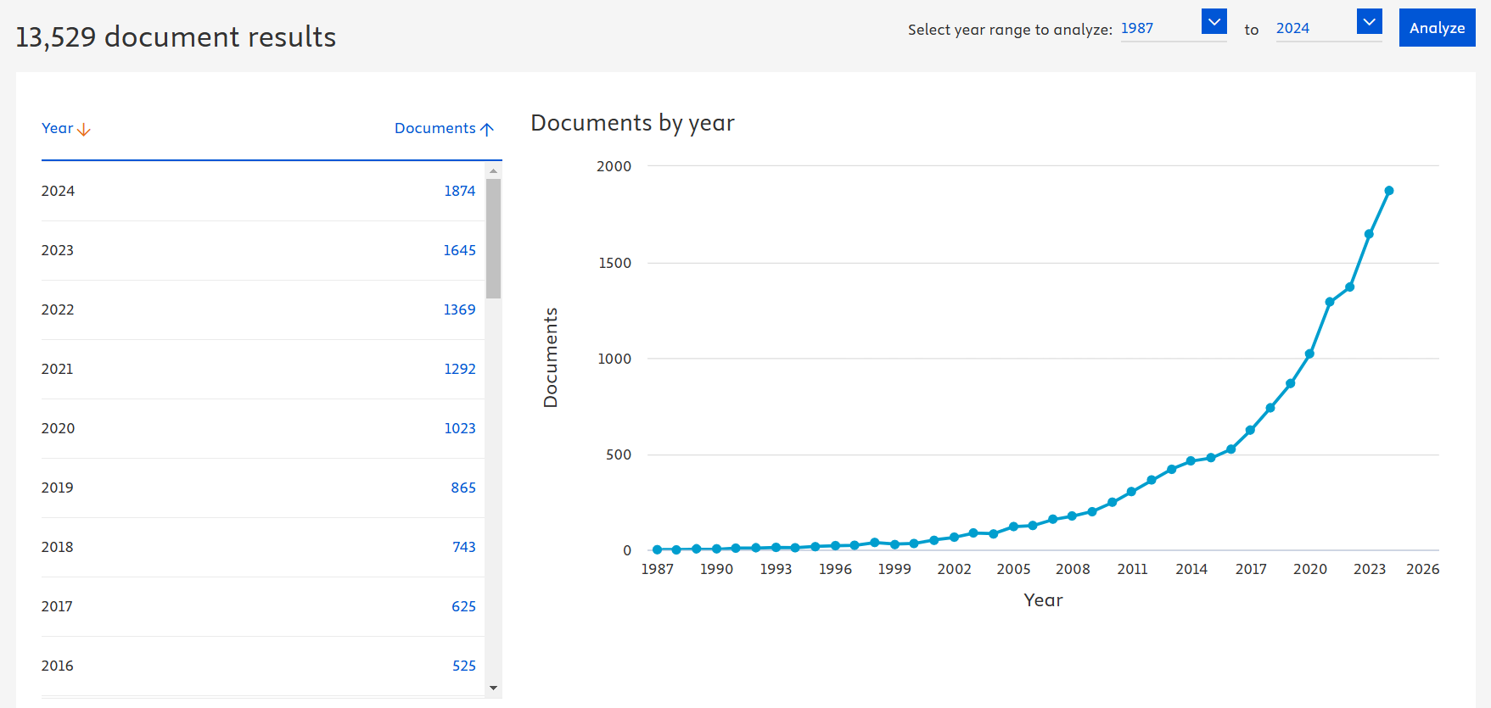
Quality of Life and Sustainability in SCOPUS (Article title, Keyword, Abstract)

Slide 17
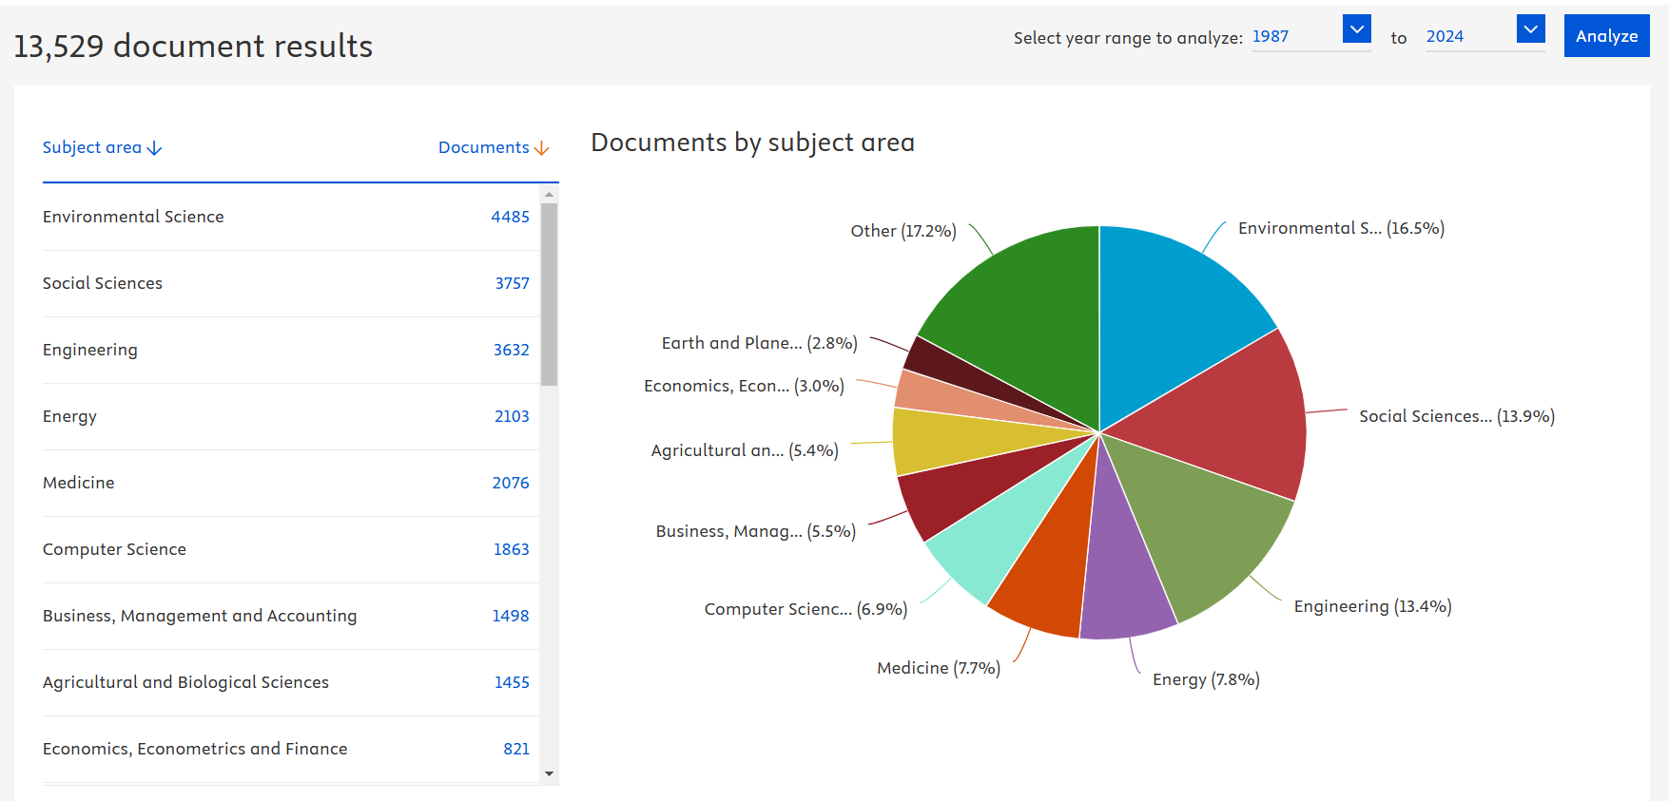

Slide 18
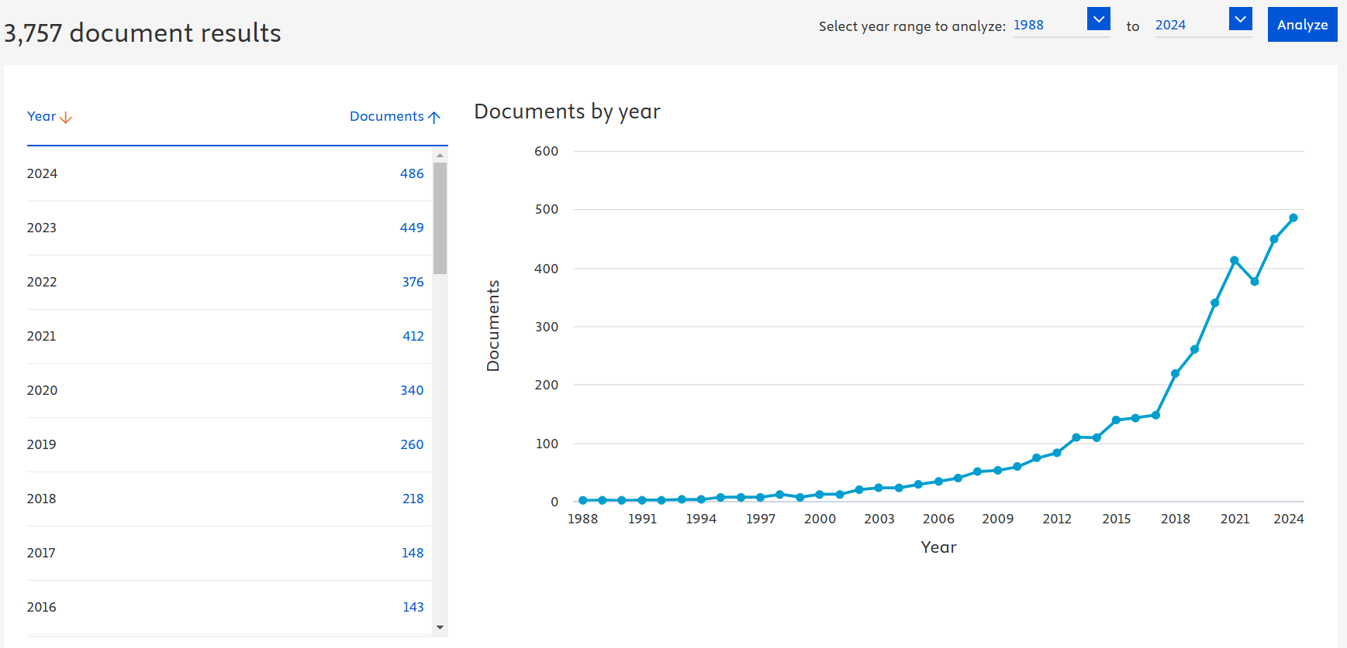
Quality of Life and Sustainability in Social Sciences research

Slide 19
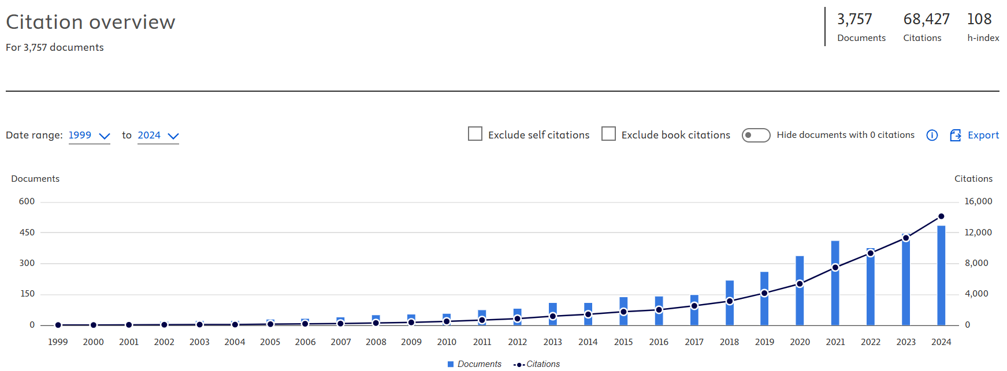

Slide 20
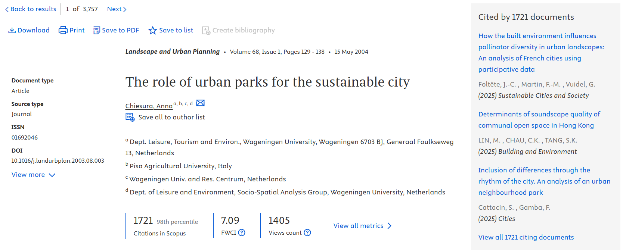
The highest citation in Scopus

Slide 21
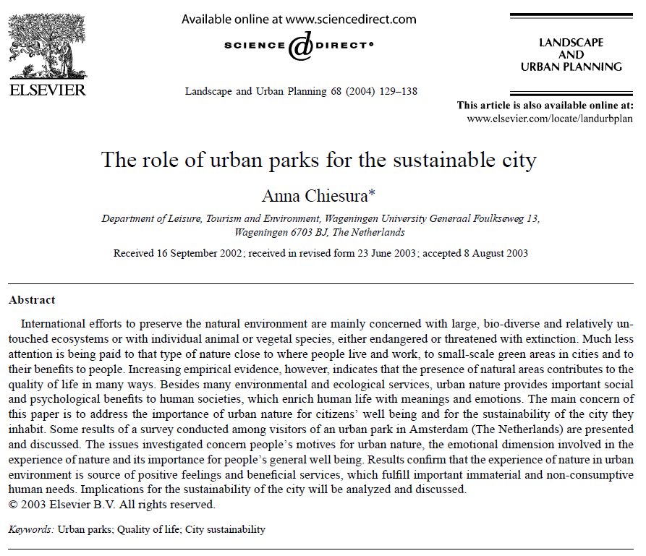
Chiesura, A. (2004). The role of urban parks for the sustainable city. Landscape and Urban planning, 68, 129-138.

Slide 22
Chiesura (2004) concludes that urban parks play a vital role in the sustainability of cities by providing numerous benefits, including:
Environmental services: Parks help to purify air and water, reduce noise pollution, and moderate the urban microclimate.
Social and psychological benefits: Parks offer spaces for recreation, social interaction, and relaxation, which can contribute to improved mental and physical health.
Enhanced quality of life: The presence of green spaces in urban areas has been linked to increased property values, reduced crime rates, and a greater sense of community.
This article emphasizes the importance of considering the intangible benefits of urban parks, such as their contribution to human well-being and the aesthetic quality of the urban environment, in planning and management decisions.
This research suggests that by investing in urban parks, cities can create more livable, resilient, and sustainable environments for their residents.
Source: Chiesura, A. (2004). The role of urban parks for the sustainable city. Landscape and Urban planning, 68, 129-138.

Slide 23
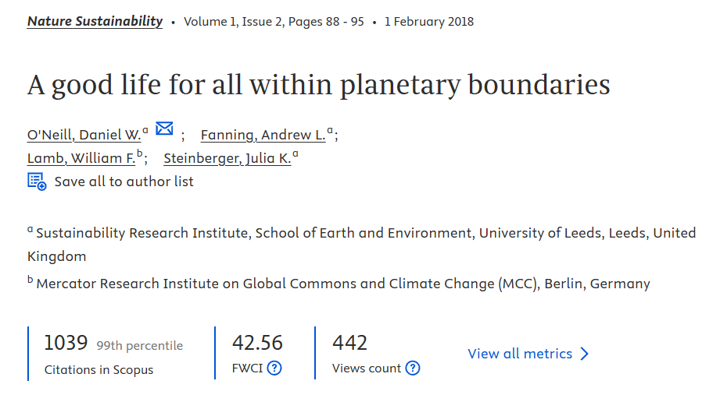
The second highest citation in Scopus
Source: O’Neill, D. W., Fanning, A. L., Lamb, W. F., & Steinberger, J. K. (2018). A good life for all within planetary boundaries. Nature sustainability, 1(2), 88-95.

Slide 24
O'Neill et al. (2018) conclude that it is possible to provide a good life for all people on Earth within planetary boundaries, but it will require a significant shift in resource consumption and production patterns.
key findings:
No country currently meets the basic needs of its citizens at a globally sustainable level of resource use. This means that all countries are exceeding at least one planetary boundary, putting the Earth's systems at risk.
Meeting basic needs for all people is possible within planetary boundaries. This can be achieved by prioritizing essential needs like nutrition, sanitation, access to electricity, and eliminating extreme poverty.
Significant reductions in resource use are necessary, particularly in wealthy nations. High-income countries will need to drastically reduce their consumption to allow for a more equitable distribution of resources.
Social provisioning systems are crucial. These systems, which include healthcare, education, and social support, are essential for ensuring a good life for all, even with reduced material consumption.
Source: O’Neill, D. W., Fanning, A. L., Lamb, W. F., & Steinberger, J. K. (2018). A good life for all within planetary boundaries. Nature sustainability, 1(2), 88-95.

Slide 25
1. Environmental Sustainability
Clean Air and Water
Healthy Ecosystems
Climate Change Mitigation

Slide 26

The Urgency of Environmental Sustainability
Environmental sustainability and its importance for current and future generations.
Briefly introduce the three pillars: environment, society, and economy.
The interconnectedness of clean air, clean water, healthy ecosystems, and climate change.

Slide 27
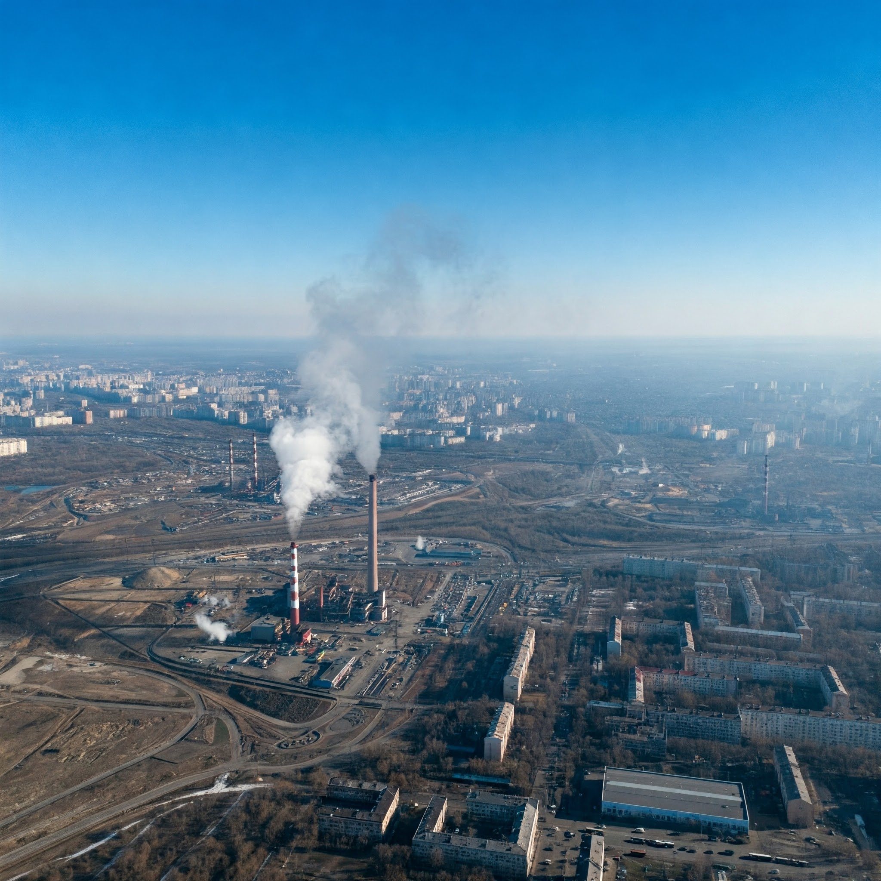

Clean Air
Air Pollution Sources: Industrial emissions, transportation, agriculture, residential sources.
Health Impacts: Respiratory diseases, cardiovascular problems, cancer.
Recent Research: Air quality monitoring technologies, innovative filtration systems, policy interventions, governance, and policy.
  Discussion Point: The role of technology and policy in achieving clean air goals.

Slide 28
Grossberndt, S., Passani, A., Di Lisio, G., Janssen, A., & Castell, N. (2021). Transformative potential and learning outcomes of air quality citizen science projects in high schools using low-cost sensors. Atmosphere, 12(6), 736.

Slide 29
Aspect | Description
Introduction/Pain Point | Growing concern about air quality and its impact on health. Need for increased public awareness and engagement in air quality issues. Potential of citizen science to empower individuals and communities to monitor and address air pollution.
Gap in Knowledge | Limited understanding of the transformative potential and learning outcomes of air quality citizen science projects, particularly in high school settings using low-cost sensors.
Objectives | To assess the impact and transformative potential of air quality citizen science projects in high schools using low-cost sensors. To investigate the learning outcomes of these projects on students' knowledge, attitudes, and behaviors related to air quality.
Research Questions | What is the impact of air quality citizen science projects on high school students' learning and attitudes towards science and environmental issues? How do these projects contribute to students' understanding of air quality and their engagement in pro-environmental behaviors?
Concept Applied | Citizen science approach: Engaging high school students in authentic scientific research using low-cost sensors. Experiential learning: Providing students with hands-on experience in collecting, analyzing, and interpreting air quality data.

Slide 30
Aspect | Description
Methodology | Mixed-methods approach: Combining quantitative and qualitative data collection methods. Pre- and post-project surveys to assess changes in students' knowledge, attitudes, and behaviors.
Findings | Positive learning outcomes: Increased knowledge of air quality, improved scientific inquiry skills, and more pro-environmental attitudes. Transformative potential: Students felt empowered to take action on air pollution in their communities. Limited behavioral change: While students expressed intentions to change their behavior, there was limited evidence of actual changes.
Discussion | Air quality citizen science projects using low-cost sensors have the potential to enhance learning outcomes and promote pro-environmental attitudes among high school students. Further research is needed to explore the long-term impacts of these projects and identify strategies to promote behavioral change.
Recommendations | Integrate air quality citizen science projects into high school curricula to provide students with authentic learning experiences.

Slide 31
Boso, À., Garrido, J., Sánchez-Galvis, L. K., Rodríguez, I., & Vallejos-Romero, A. (2024). Exploring role-playing as a tool for involving citizens in air pollution mitigation urban policies. Humanities and Social Sciences Communications, 11(1), 1-11.

Slide 32
Aspect | Description
1. Intro, Pain Point, Gap | Intro: Explores the use of role-playing as a tool to involve citizens in the design and implementation of urban air pollution mitigation policies. Pain Point: Traditional top-down approaches to environmental policymaking often lack citizen input, leading to policies that may not be effective or accepted by the public. Gap: Need for innovative methods to engage citizens in a meaningful way and incorporate their knowledge and preferences into air quality management.
2. Objectives | Assess the potential of role-playing to enhance citizen participation in air pollution mitigation policies. Evaluate how role-playing influences citizens' perceptions of air pollution problems and potential solutions.
3. Research Question | How can role-playing be used as a tool to effectively involve citizens in the development and implementation of urban air pollution mitigation policies?
4. Concept Applied | Citizen participation: Involving the public in decision-making processes that affect their lives. Role-playing: A simulation technique where participants assume roles and interact to explore different

Slide 33
Aspect | Description
5. Methodology | Qualitative research: Uses role-playing workshops with citizens in six mid-sized cities in southern Chile. Data collection: Observations of role-playing sessions, analysis of policy documents, and semi-structured interviews with participants. Data analysis: Thematic analysis of qualitative data to identify key themes and patterns.
6. Findings | Role-playing can effectively engage citizens in discussing air pollution issues and potential solutions. Participants gained a deeper understanding of the complexity of air pollution and the trade-offs involved in policymaking. Role-playing fostered empathy and collaboration among participants with diverse perspectives. The process generated creative and context-specific policy ideas.
7. Discussion | Role-playing can be a valuable tool for bridging the gap between citizens and policymakers in environmental governance. The approach allows citizens to actively contribute to policy design and implementation, enhancing the legitimacy and effectiveness of policies. Role-playing can promote social learning, build trust, and empower communities to address environmental challenges.
8. Recommendations | Integrate role-playing into urban air pollution mitigation planning processes. Adapt the role-playing approach to different contexts and scales. Combine role-playing with other participatory methods to create a comprehensive citizen engagement strategy.

Slide 34
Aspect and key points from other research
Aspect | Key Points
Air Quality Control | Collaborative Governance: Effective air quality control often involves collaborative governance, which has shown positive impacts on reducing pollutants. Monitoring and Data Dissemination: Comprehensive air quality monitoring and public access to data are essential for understanding and managing air quality.
Policy | Integrated Policy Approaches: Policies should integrate air quality and climate change considerations to maximize benefits and avoid unintended consequences. Governance Frameworks: Strong governance frameworks, including corruption control and regulatory quality, are vital for effective air pollution management. Ecological Compensation: Policies like ecological compensation can incentivize local governments to improve air quality by linking financial rewards to environmental performance.
Governance | Collaborative and Multi-level Governance: Effective governance involves collaboration across different levels of government and sectors, as seen in the EU's integrated approach to sustainability. Local and Regional Coordination: Local and regional coordination mechanisms are necessary for effective air quality management, as demonstrated in various case studies. Public Participation and Awareness: Engaging the public and raising awareness about air quality issues are critical for the success of environmental policies.

Slide 35
Reference
Atkinson, R., & Klausen, J. E. (2011). Understanding sustainability policy: Governance, knowledge and the search for integration [Article]. Journal of Environmental Policy and Planning, 13(3), 231-251. https://doi.org/10.1080/1523908X.2011.578403
Carmichael, L., & Lambert, C. (2011). Governance, knowledge and sustainability: The implementation of EU directives on air quality in Southampton [Review]. Local Environment, 16(2), 181-191. https://doi.org/10.1080/13549839.2011.562490
Chang, D., Zhang, Z., Song, H., Wu, J., Wang, X., & Dong, Z. (2024). “Icing on the cake” or “fuel delivered in the snow”? Evidence from China on ecological compensation for air pollution control [Article]. Environmental Impact Assessment Review, 109, Article 107620. https://doi.org/10.1016/j.eiar.2024.107620
Harish, S. (2021). Air Quality Management in India at the Crossroads [Review]. Economic and Political Weekly, 56(52), 38-45. https://www.scopus.com/inward/record.uri?eid=2-s2.0-85127365395&partnerID=40&md5=4516cd6f4eeb3839dfe04727c1677097
Isley, C. F., & Taylor, M. P. (2018). Air quality management in the Pacific Islands: A review of past performance and implications for future directions [Review]. Environmental Science and Policy, 84, 26-33. https://doi.org/10.1016/j.envsci.2018.02.013
Melamed, M. L., Schmale, J., & von Schneidemesser, E. (2016). Sustainable policy—key considerations for air quality and climate change [Review]. Current Opinion in Environmental Sustainability, 23, 85-91. https://doi.org/10.1016/j.cosust.2016.12.003
Tayebi, M., Bemani, A., Fetanat, A., & Fehresti-Sani, M. (2022). A decision support system for sustainability prioritization of air pollution control technologies in energy and carbon management: Oil & gas industry of Iran [Article]. Journal of Natural Gas Science and Engineering, 99, Article 104416. https://doi.org/10.1016/j.jngse.2022.104416
Varghese, K., & Mohan, M. P. R. (2017). Air quality data dissemination; Legal and policy challenges [Review]. Economic and Political Weekly, 52(41), 25-27. https://www.scopus.com/inward/record.uri?eid=2-s2.0-85031108367&partnerID=40&md5=774fc65268112344cbddc14fefcbd20b
Wang, Y., Antohi, V. M., Fortea, C., Zlati, M. L., Mohammad, R. A., Abdelkhair, F. Y. F., & Ahmad, W. (2024). Shadow Economy and Environmental Sustainability in Global Developing Countries: Do Governance Indicators Play a Role? [Article]. Sustainability (Switzerland), 16(22), Article 9852. https://doi.org/10.3390/su16229852
Xu, M., & Wu, J. (2020). Can Chinese-style environmental collaboration improve the air quality? A quasi-natural experimental study across Chinese cities [Article]. Environmental Impact Assessment Review, 85, Article 106466. https://doi.org/10.1016/j.eiar.2020.106466

Slide 36
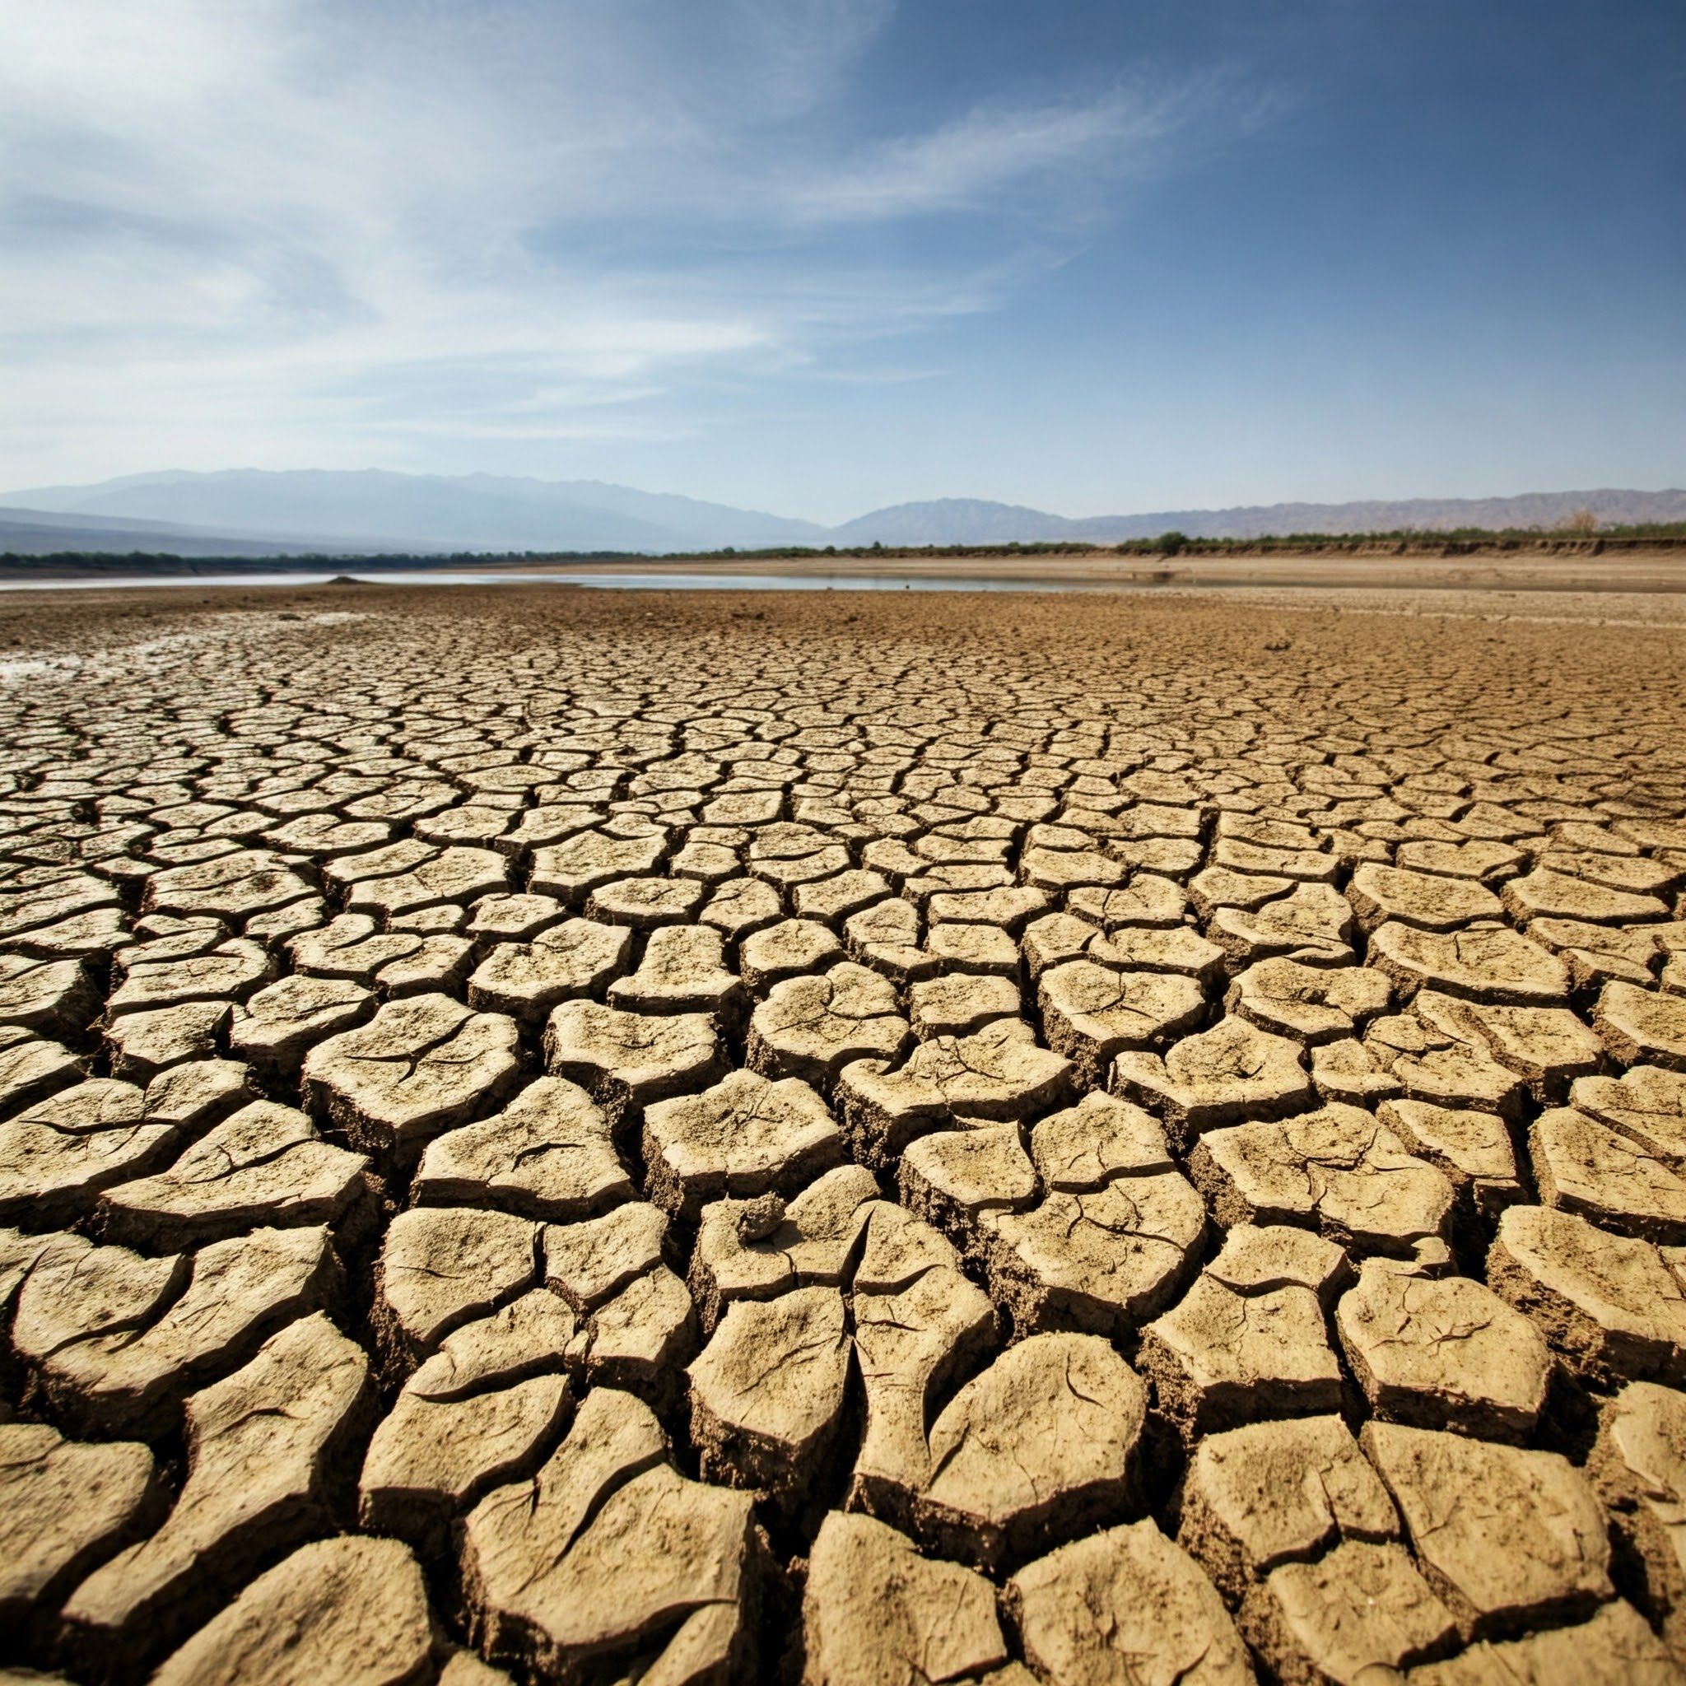
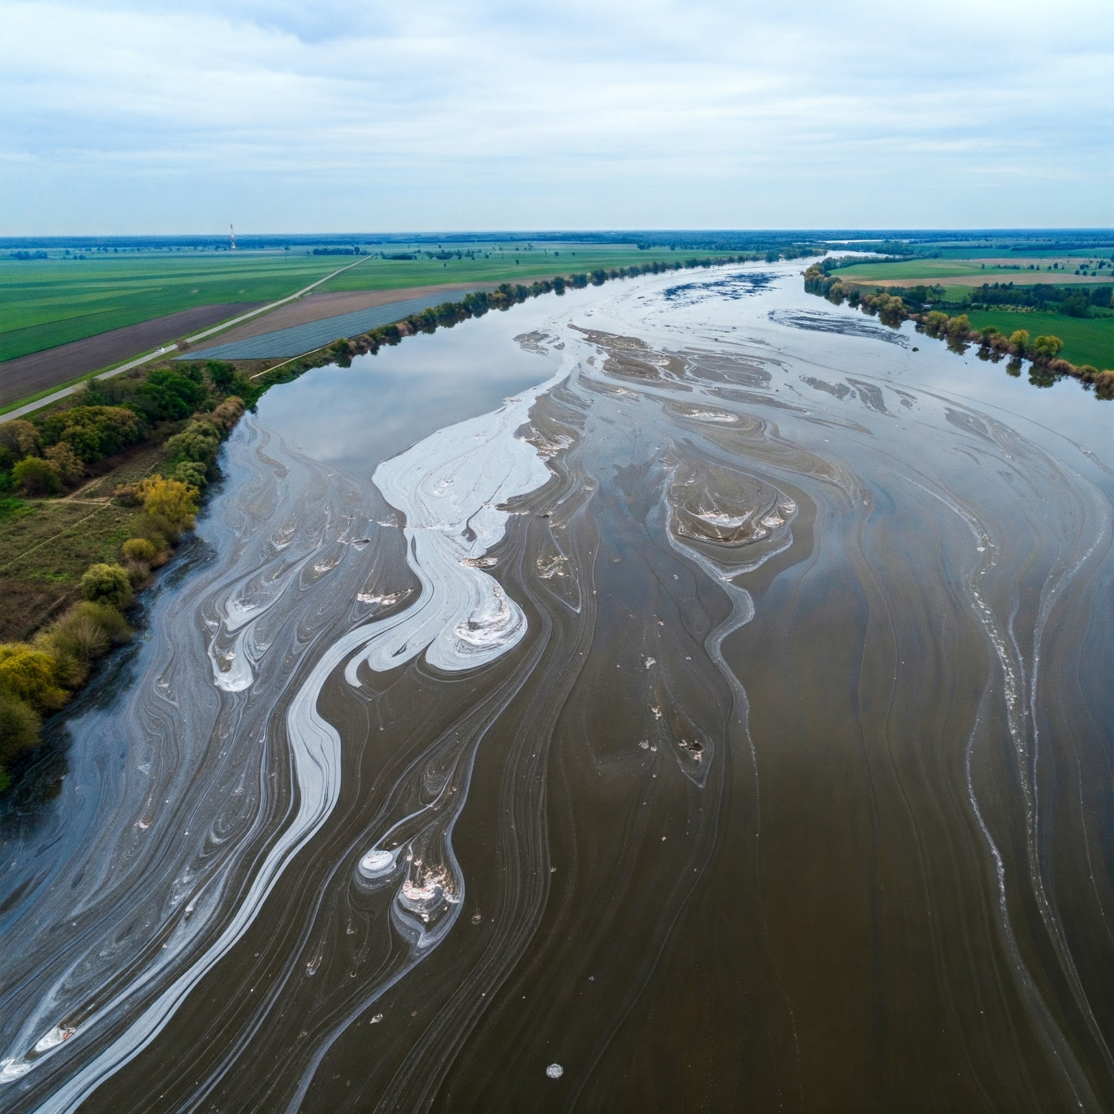
Clean Water
Water Scarcity and Pollution: Depleting groundwater, industrial and agricultural runoff, plastic pollution.
Impacts on Human Health and Ecosystems: Waterborne diseases, threats to aquatic biodiversity, food security.
Recent Research: Wastewater treatment, sustainable water management practices.
Discussion Point: The link between water security and social equity.

Slide 37
Zlati, M. L., Antohi, V. M., Ionescu, R. V., Iticescu, C., & Georgescu, L. P. (2024). Quantyfing the impact of the water security index on socio-economic development in EU27. Socio-Economic Planning Sciences, 93, 101912.

Slide 38
Category | Description
Introduction/Pain Point | Water security is crucial, but inequities exist in its distribution. Current understanding of "water risk" often focuses on biophysical factors, neglecting the social and political dimensions that create these inequities.
Gap in Knowledge | Lack of a framework that integrates water risk with considerations of equity and justice in water security.
Objectives | Re-orient the concept of water risk to better understand inequities in water security. Develop a framework that embeds water risk within a broader understanding of water security, incorporating social and political dimensions.
Research Questions | How can the concept of water risk be re-oriented to better understand inequities in water security? How do power dynamics and political processes influence water risk and water security?

Slide 39
Category | Description
Methodology | 61 interviews with diverse stakeholders (farmers, government officials, NGO representatives). 17 industrial water user surveys.
Findings | Water risk is experienced differently by different groups due to social, economic, and political inequalities. Power dynamics and political processes significantly influence who is exposed to water risks and who benefits from water resources. Re-orienting water risk towards a focus on "water-related values" (e.g., livelihoods, cultural practices, ecological health) can reveal hidden inequities.
Discussion | A broader understanding of water risk is needed, one that goes beyond biophysical factors to include social and political dimensions. This re-orientation can help identify and address the root causes of water insecurity and promote more equitable water management.
Recommendations | Integrate equity considerations into water risk assessments and management strategies. Empower marginalized communities and ensure their participation in water governance.

Slide 40
Aspect and key points from other research
Aspect | Key Points
Wastewater Treatment | Resource Recovery: Emphasis on integrating water reuse, energy recovery, and nutrient recycling to enhance sustainability. Environmental Impact: Focus on reducing pollutants, energy use, and greenhouse gas emissions. Circular Economy: Utilizing treated wastewater for agriculture, groundwater recharge, and energy production
Sustainable Water Management Practices | Holistic Approach: Integrating societal, economic, and environmental aspects to manage water resources sustainably. Innovative Practices: Development of water-efficient agricultural practices and urban water reuse. Policy and Regulation: Need for new policy measures and international standards for sustainable water use. Climate Adaptation: Mitigating and adapting to climate change impacts on water resources.
Impacts on Human Health and Ecosystems | Health Benefits: Improved wastewater treatment reduces disease mortality and enhances public health. Ecosystem Health: Treated wastewater can still impact ecosystems, affecting biodiversity and nutrient cycles. Pollutant Management: Addressing micropollutants and antibiotic-resistant bacteria in treated effluents. Water Quality: Ensuring treated wastewater meets safety standards to protect human and ecological health.

Slide 41
Reference
Boros, A., Gordos, B., & Tőzsér, D. (2024). A bibliometric analysis-based literature review of the relationship between sustainable water management and green innovations in the agricultural sector [Review]. Heliyon, 10(12), Article e33364. https://doi.org/10.1016/j.heliyon.2024.e33364
Burdon, F. J., Bai, Y., Reyes, M., Tamminen, M., Staudacher, P., Mangold, S., Singer, H., Räsänen, K., Joss, A., Tiegs, S. D., Jokela, J., Eggen, R. I. L., & Stamm, C. (2020). Stream microbial communities and ecosystem functioning show complex responses to multiple stressors in wastewater [Article]. Global Change Biology, 26(11), 6363-6382. https://doi.org/10.1111/gcb.15302
Chaudhary, R., & Pandey, A. (2016). Role of indicators for Attain sustainability for advanced wastewater technologies: A mini review [Article]. Indian Journal of Environmental Protection, 36(3), 176-185. https://www.scopus.com/inward/record.uri?eid=2-s2.0-84991738749&partnerID=40&md5=605dc438e0a6a5932b42fa2bacec983e
Cornejo, P. K., Zhang, Q., & Mihelcic, J. R. (2016). How Does Scale of Implementation Impact the Environmental Sustainability of Wastewater Treatment Integrated with Resource Recovery? [Article]. Environmental Science and Technology, 50(13), 6680-6689. https://doi.org/10.1021/acs.est.5b05055
de Guzman, I., Elosegi, A., von Schiller, D., González, J. M., Paz, L. E., Gauzens, B., Brose, U., Antón, A., Olarte, N., Montoya, J. M., & Larrañaga, A. (2023). Treated and highly diluted, but wastewater still impacts diversity and energy fluxes of freshwater food webs [Article]. Journal of Environmental Management, 345, Article 118510. https://doi.org/10.1016/j.jenvman.2023.118510
Fatta, D., Salem, Z., Mountadar, M., Assobhei, O., & Loizidou, M. (2004). Urban wastewater treatment and reclamation for agricultural irrigation: The situation in Morocco and Palestine [Article]. Environmentalist, 24(4), 227-236. https://doi.org/10.1007/s10669-005-0998-x
Naik, K. S., & Stenstrom, M. K. (2012). Evidence of the influence of wastewater treatment on improved public health [Article]. Water Science and Technology, 66(3), 644-652. https://doi.org/10.2166/wst.2012.144
Pereda, O., Solagaistua, L., Atristain, M., de Guzmán, I., Larrañaga, A., von Schiller, D., & Elosegi, A. (2020). Impact of wastewater effluent pollution on stream functioning: A whole-ecosystem manipulation experiment [Article]. Environmental Pollution, 258, Article 113719. https://doi.org/10.1016/j.envpol.2019.113719
Schaum, C., & Cornel, P. (2016). Sewage treatment of the future: health, water and resource protection [Article]. Osterreichische Wasser- und Abfallwirtschaft, 68(3-4), 134-145. https://doi.org/10.1007/s00506-016-0296-5
Silva, J. A. (2023). Wastewater Treatment and Reuse for Sustainable Water Resources Management: A Systematic Literature Review [Review]. Sustainability (Switzerland), 15(14), Article 10940. https://doi.org/10.3390/su151410940
Thomas-Cole, S., Weinbauer, J., & Galya, D. (2011). An essential resource: Water Management, conservation, and preservation [Article]. EM: Air and Waste Management Association's Magazine for Environmental Managers(MAY), 8-12. https://www.scopus.com/inward/record.uri?eid=2-s2.0-79960132424&partnerID=40&md5=68a6f287ab95677b419f278dda8fbb41

Slide 42
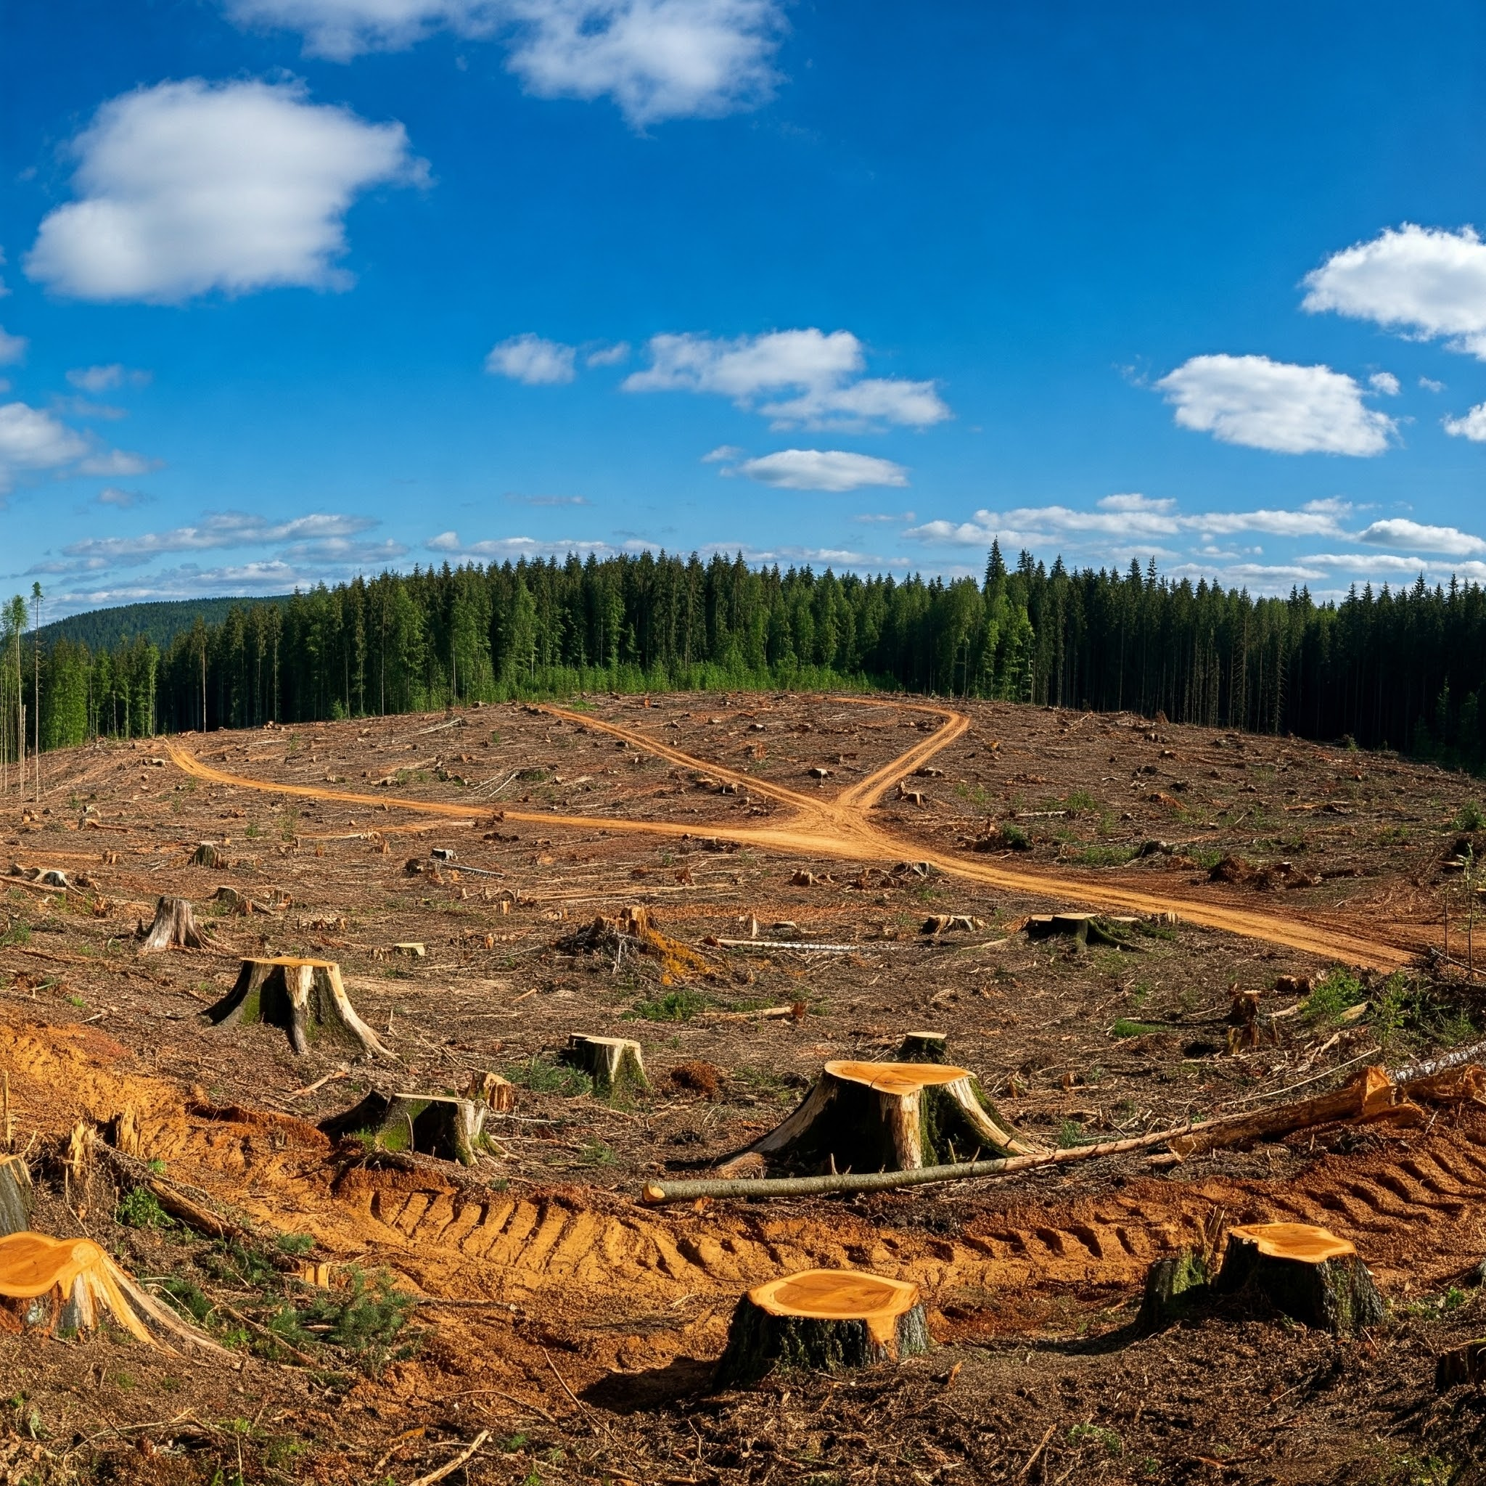
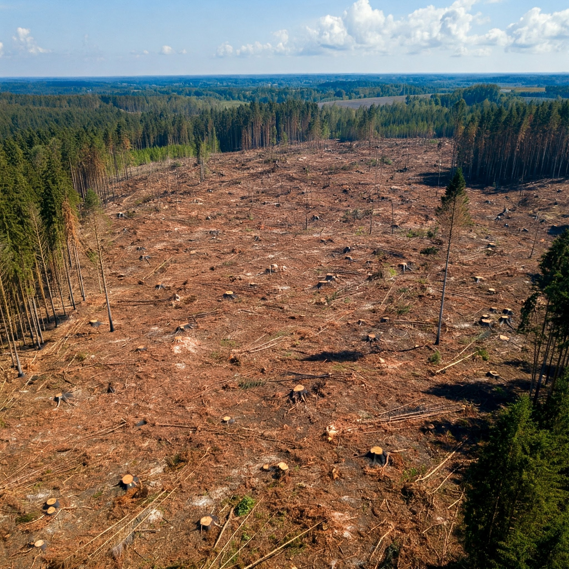
Healthy Ecosystems
The benefits of healthy ecosystems (e.g., pollination, carbon sequestration, climate regulation).
Threats to Biodiversity: Habitat loss, invasive species, climate change, overexploitation.
Recent Research: Ecosystem restoration projects, conservation efforts, sustainable agriculture.
Discussion Point: Discuss the ethical considerations related to biodiversity conservation.

Slide 43
Armitage, D., Mbatha, P., Muhl, E. K., Rice, W., & Sowman, M. (2020). Governance principles for community‐centered conservation in the post‐2020 global biodiversity framework. Conservation Science and Practice, 2(2), e160.

Slide 44
Category | Description
Introduction/Pain Point | Global biodiversity conservation efforts have had limited success. Need for transformative change in conservation approaches. Importance of recognizing and supporting the rights and roles of Indigenous Peoples and Local Communities (IPLCs) in conservation.
Gap in Knowledge | Lack of clarity on specific governance principles needed for effective community-centered conservation. Limited understanding of how to integrate IPLCs into conservation frameworks and decision-making processes.
Objectives | Define and critically reflect on core principles of community-centered conservation governance. Provide guidance for the implementation of the post-2020 global biodiversity framework.
Research Questions | What are the key governance principles that can ensure effective and equitable community-centered conservation? How can these principles be implemented in the post-2020 global biodiversity framework?

Slide 45
This research conclude that the post-2020 global biodiversity framework should prioritize a community-centered approach to governance.
Recognizing and empowering indigenous peoples and local communities is crucial for achieving effective and equitable conservation outcomes.
Emphasizing the need for governance principles that prioritize community agency, rights-based approaches, and collaborative partnerships.
This includes fostering multi-level networks, promoting equity and recognizing the role of women, addressing historical injustices, and supporting customary institutions. This means that by adopting these principles, the post-2020 framework can shift away from traditional, top-down approaches to conservation and instead create a system that is more inclusive and sustainable for both biodiversity and the human communities who depend on it.

Slide 46
Aspect and key points from other research
Key Points | Description
Resilience and Adaptability | Emphasizing the need for ecosystems to be resilient and adaptable to changes, ensuring long-term sustainability.
Ecosystem Stewardship | Promoting responsible management and care of ecosystems to navigate changes effectively.
Human Health and Well-being | Recognizing the link between ecosystem health and human health, and integrating public health considerations into restoration projects.
Social and Political Dimensions | Addressing the social and political factors that influence restoration efforts, ensuring inclusivity and equity.
Climate Change Mitigation | Implementing restoration projects that contribute to climate change mitigation by enhancing carbon storage and ecosystem resilience.
Biodiversity Conservation | Focusing on the conservation of biodiversity as a fundamental goal of restoration efforts.
Community and Stakeholder Engagement | Engaging local communities and stakeholders in the planning and implementation of restoration projects to ensure their success and sustainability.
Sustainable Development Goals (SDGs) | Aligning restoration efforts with the broader objectives of the SDGs to achieve ecological, economic, and social benefits.

Slide 47
Reference
Aronson, J., Goodwin, N., Orlando, L., Eisenberg, C., & Cross, A. T. (2020). A world of possibilities: six restoration strategies to support the United Nation's Decade on Ecosystem Restoration [Article]. Restoration Ecology, 28(4), 730-736. https://doi.org/10.1111/rec.13170
Cross, A. T., Nevill, P. G., Dixon, K. W., & Aronson, J. (2019). Time for a paradigm shift toward a restorative culture [Article]. Restoration Ecology, 27(5), 924-928. https://doi.org/10.1111/rec.12984
Elias, M., Joshi, D., & Meinzen-Dick, R. (2021). Restoration for whom, by whom? A feminist political ecology of restoration [Review]. Ecological Restoration, 39(1-2), 1-2. https://doi.org/10.3368/er.39.1-2.1
Fischer, J., Riechers, M., Loos, J., Martin-Lopez, B., & Temperton, V. M. (2021). Making the UN Decade on Ecosystem Restoration a Social-Ecological Endeavour [Review]. Trends in Ecology and Evolution, 36(1), 20-28. https://doi.org/10.1016/j.tree.2020.08.018
Janishevski, L., Santamaria, C., Gidda, S. B., Cooper, H. D., & Brancalion, P. H. S. (2015). Ecosystem restoration, protected areas and biodiversity conservation [Article]. Unasylva, 66(245), 19-28. https://www.scopus.com/inward/record.uri?eid=2-s2.0-84956908221&partnerID=40&md5=1884eccdeac1fb97031e0936dd6e40a0
Jurjonas, M., May, C. A., Cardinale, B., Kyriakakis, S., Pearsall, D. R., & Doran, P. J. (2024). The perceived ecological and human well-being benefits of ecosystem restoration [Article]. People and Nature, 6(1), 4-19. https://doi.org/10.1002/pan3.10558
Li, F., Cheng, C., & Yang, R. (2022). A review of ecosystem restoration: Progress and prospects of domestic and abroad [Review]. Biodiversity Science, 30(10), Article 22519. https://doi.org/10.17520/biods.2022519
Lilli, M. A., Nerantzaki, S. D., Riziotis, C., Kotronakis, M., Efstathiou, D., Kontakos, D., Lymberakis, P., Avramakis, M., Tsakirakis, A., Protopapadakis, K., & Nikolaidis, N. P. (2020). Vision-based decision-making methodology for riparian forest restoration and flood protection using nature-based solutions [Article]. Sustainability (Switzerland), 12(8), Article 3305. https://doi.org/10.3390/SU12083305
Liu, J., Cui, W., Tian, Z., & Jia, J. (2021). Theory of stepwise ecological restoration [Article]. Kexue Tongbao/Chinese Science Bulletin, 66(9), 1014-1025. https://doi.org/10.1360/TB-2020-1128
Pape, T. (2020). Futuristic restoration: an oxymoronic paradigm for an idiosyncratic place in time [Article]. Restoration Ecology, 28(6), 1321-1323. https://doi.org/10.1111/rec.13265

Slide 48
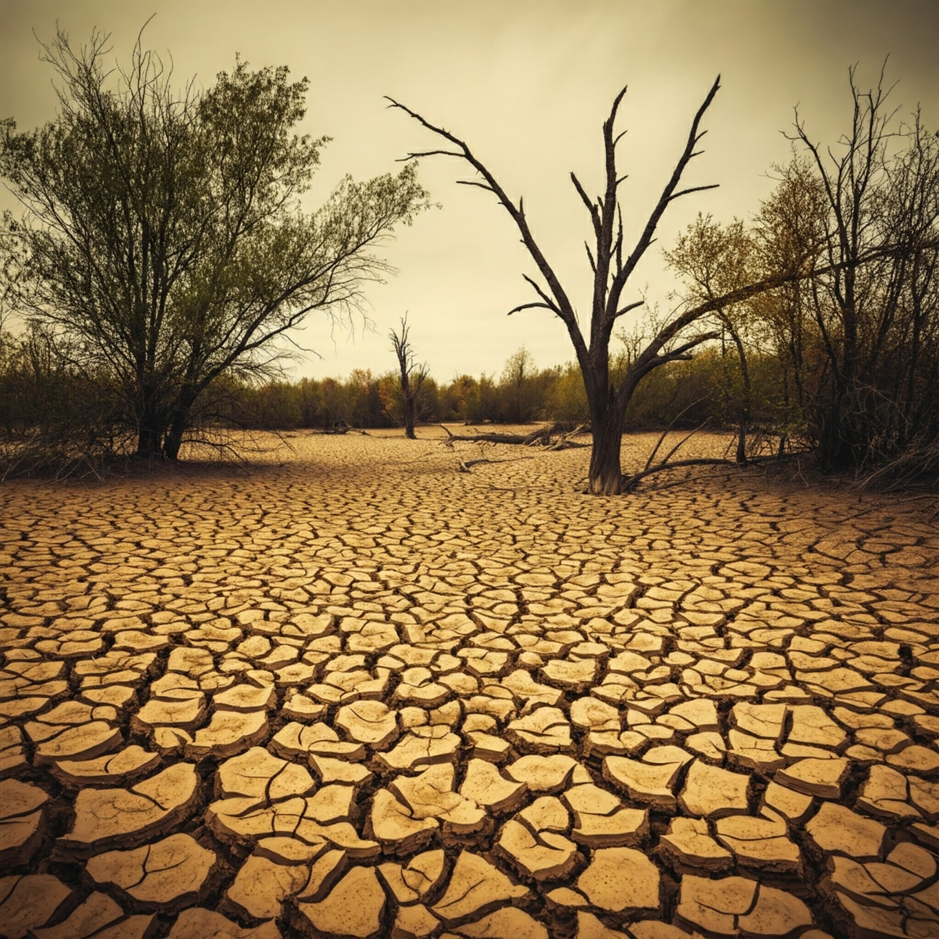

Climate Change Mitigation
Greenhouse Effect and Global Warming: Briefly explain the science behind climate change.
Impacts of Climate Change: Extreme weather events, sea-level rise, threats to human health and economies.
Mitigation Strategies: Renewable energy, energy efficiency, sustainable transportation, carbon capture.
Discussion Point: The individual and collective actions for climate change mitigation.

Slide 49
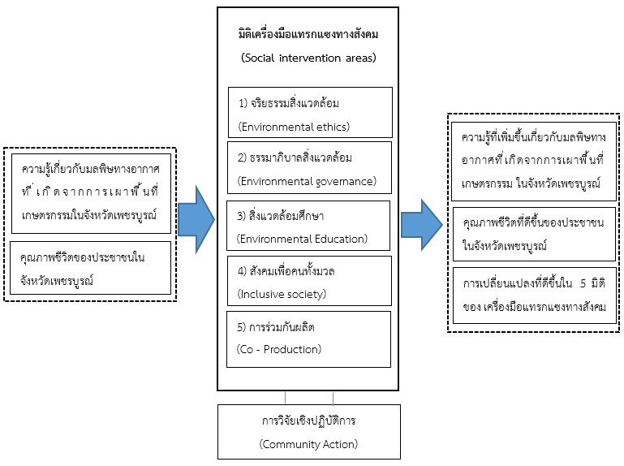
FF 2569
Title: Mitigating agricultural burning-induced haze pollution through social interventions: A case study of Phetchabun province
Pain point ภาคเหนือเป็นภูมิภาคที่มีปัญหามลพิษทางอากาศจากการเผามากที่สุด และเมื่อพิจารณาเป็นรายจังหวัดในภาคเหนือ พบว่า จังหวัดที่พบจุดความร้อนมากที่สุด ที่มีสาเหตุมาจากการเผาพื้นที่เกษตรกรรม ได้แก่ จังหวัดเพชรบูรณ์

Slide 50
Category | Key Points
Renewable Energy | Reduction of Greenhouse Gas Emissions: Renewable energy sources significantly contribute to reducing greenhouse gas emissions, aiding in climate change mitigation.
 | Energy Transition: A shift from fossil fuels to renewable energy is essential for achieving sustainability goals, with a target of 60-70% renewable energy by 2050.
 | Economic and Social Benefits: Renewable energy development can lead to regional development, job creation, and social cohesion.
 | Challenges: Potential negative externalities include habitat fragmentation, resource overuse, and social conflicts.
Sustainable Transportation | Zero Emissions and Accidents: Goals include achieving zero road accidents, zero traffic emissions, and zero congestion through intelligent technologies like IoT and data analysis.
 | Integration with SDGs: Sustainable transportation is aligned with several Sustainable Development Goals (SDGs), including safe, affordable, and accessible transport systems for all.
 | Innovations and Policies: Innovations and effective public policies are necessary to reduce the carbon footprint and improve the quality of life.
 | Economic Impact: Sustainable transportation can enhance economic performance by improving vehicle capacity utilization and promoting the use of biodiesel.
 | Human Factors: Understanding and addressing human behavior is critical for improving road safety and reducing traffic fatalities.
 | Environmental Impact: Sustainable transportation aims to minimize air pollution, noise, and solid waste from vehicles, contributing to overall environmental sustainability.

Slide 51
Reference
Andea, P., Mnerie, D., Cristian, D., Pop, O., & Jigoria-Oprea, D. (2010). Conventional vs. alternative energy sources overview part I. energy and environment. ICCC-CONTI 2010 - IEEE International Joint Conferences on Computational Cybernetics and Technical Informatics, Proceedings,
Comet, M., Khosa, D., & Mofokeng, J. T. (2024). The Impact of human factors on road traffic fatalities within Musina Local Municipality: An analysis of critical elements [Article]. OIDA International Journal of Sustainable Development, 17(5), 47-56. https://www.scopus.com/inward/record.uri?eid=2-s2.0-85211131917&partnerID=40&md5=315de4d42ffe94a94c32167fefdfb580
Kot, S., & Ojinji, S. (2023). Environmental Sustainability and Freight Transport Performance in the EU – An Autoregressive Conditional Heteroscedasticity (ARCH) Model Analysis [Article]. Promet - Traffic and Transportation, 35(5), 621-634. https://doi.org/10.7307/ptt.v35i5.293
Ma, L. (2023). Economic and social impacts of the green energy transition: A pathway towards 100% renewable energy agenda [Article]. Geological Journal, 58(9), 3438-3451. https://doi.org/10.1002/gj.4764
Niedzielski, P., & Ziolo, M. (2016). Achieving sustainable transport through innovation; theoretical and empirical approach. Transport Means - Proceedings of the International Conference,
Rojas, J., Cuta, L., Martinez, J., Pedraza, L., Ortega, P., & Fernández, H. (2024). Estimating time lost for sustainable mobility in urban environments. 2024 IEEE Colombian Conference on Communications and Computing, COLCOM 2024 - Proceedings,
Samfira, I., Horablaga, N. M., Barliba, C., Barliba, L. L., & David, S. F. (2022). COMPARATIVE ANALYSIS OF THE RENEWABLE ENERGY PRODUCTION POTENTIAL IN ROMANIA. International Multidisciplinary Scientific GeoConference Surveying Geology and Mining Ecology Management, SGEM,
Senyapar, H. N. D., & Bayindir, R. (2023). The Negative Social Impacts of Renewable Energy: A Key Consideration for a Successful Energy Transition. 12th IEEE International Conference on Renewable Energy Research and Applications, ICRERA 2023,
Yang, C., & Wei, Y. (2013). Indexes of sustainable urban transport based on a consideration of residents' living quality [Article]. Tongji Daxue Xuebao/Journal of Tongji University, 41(10), 1497-1501. https://doi.org/10.3969/j.issn.0253-374x.2013.10.008

Slide 52


Conclusion
The importance of environmental sustainability and the interconnectedness of the topics covered.
Explore further research, engage in advocacy, and adopt sustainable practices in their daily lives.

Slide 53
2. Social Sustainability
Equity and Inclusion
Community Well-being
Cultural Diversity

Slide 54
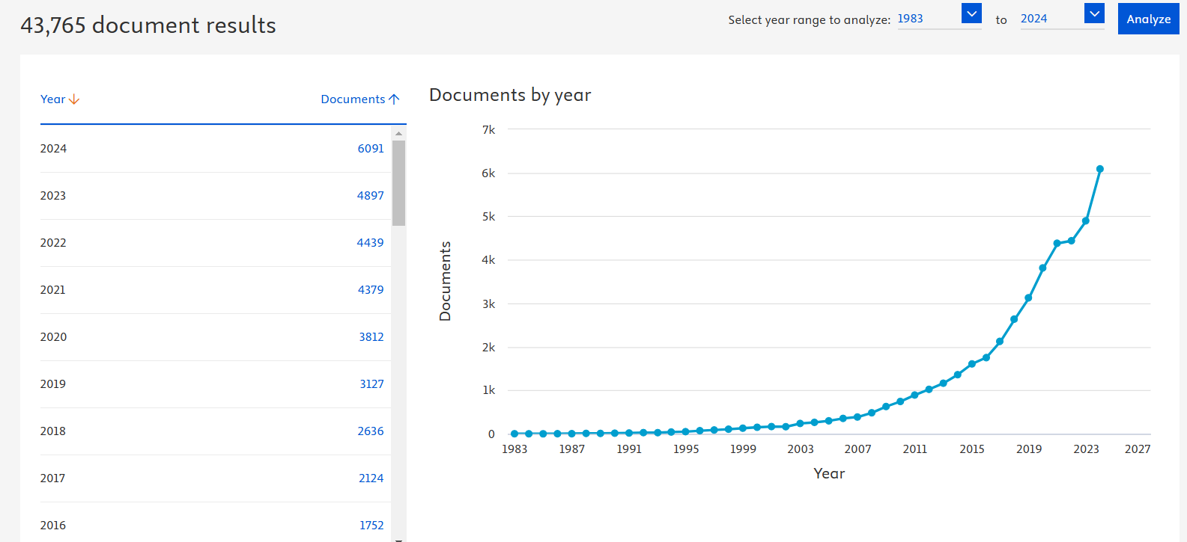
Social Sustainability in SCOPUS (Article title, Keyword, Abstract)

Slide 55

Introduction
Social sustainability: Human needs, promoting well-being, and ensuring social justice across generations.
Why Social Sustainability Matters

Slide 56
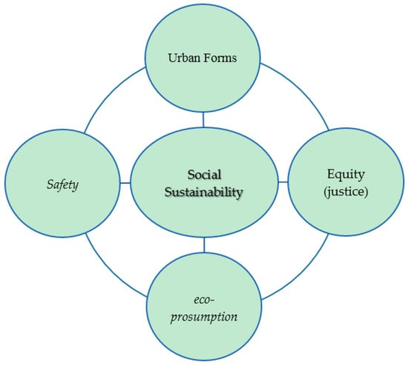
Four key concepts for social sustainability:
Equity: Including recognition of diverse identities, fair distribution of resources, and equal participation in decision-making.
Safety: Prioritizing the physical and psychological safety of individuals and communities.
Eco-prosumption: Promoting responsible production and consumption patterns that benefit both society and the environment.
Urban Forms: Designing urban spaces that foster community, health, and well-being.
Eizenberg, E., & Jabareen, Y. (2017). Social Sustainability: A New Conceptual Framework. Sustainability, 9(1), 68. https://doi.org/10.3390/su9010068

Slide 57
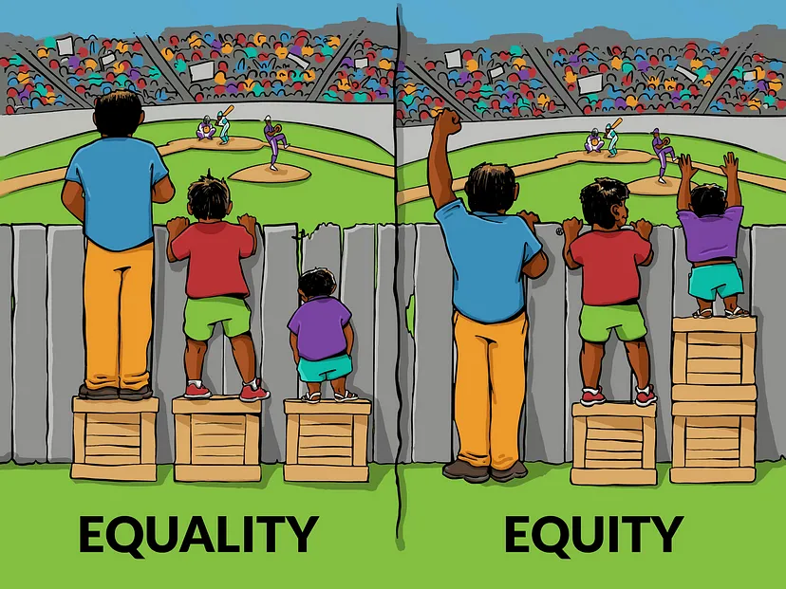
Equity and Inclusion
Distinguishing between equality and equity
Accessing to education, healthcare, economic opportunities, and reduced conflict
Marginalized groups, accessibility, and policy interventions.

Slide 58
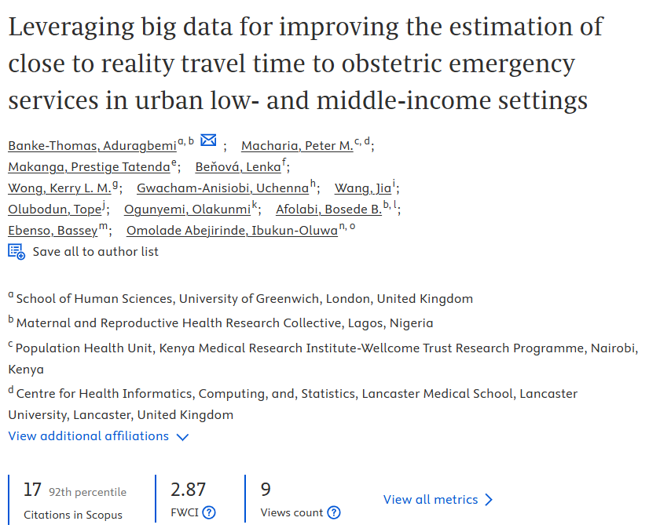
This research demonstrates the potential of leveraging big data to improve travel time estimation for obstetric emergency services in urban low- and middle-income settings. By integrating diverse datasets like GPS traces, road networks, and traffic patterns, we can create more accurate and dynamic models that reflect real-world conditions
Optimize ambulance routing: Dispatchers can make informed decisions to minimize transport times, potentially saving lives.
Identify high-risk areas: Areas with consistently long travel times can be prioritized for infrastructure improvements or increased service provision.
Empower pregnant women: Reliable travel time estimates can help women make informed choices about where to seek care and when to leave for the hospital.

Slide 59

Community Well-being
Social cohesion, safety, access to resources, and a sense of belonging
Strong social networks, healthy environments, and opportunities for participation
Examples of community-led initiatives and the role of social capital

Slide 60
Rogers, D. S., Duraiappah, A. K., Antons, D. C., Munoz, P., Bai, X., Fragkias, M., & Gutscher, H. (2012). A vision for human well-being: transition to social sustainability. Current Opinion in Environmental Sustainability, 4(1), 61-73.
Achieving social sustainability requires a fundamental shift in values and priorities, moving away from solely economic growth towards a more holistic understanding of human well-being. This involves:
Redefining progress: Measuring success beyond GDP, incorporating indicators of social well-being, environmental health, and quality of life.
Investing in social capital: Strengthening social connections, trust, and community engagement to build resilience and foster collective action.
Promoting responsible consumption and production: Shifting towards more sustainable patterns of consumption and production that minimize environmental impacts and promote social equity.
This paper call for a transformative change towards a society that prioritizes social well-being and environmental sustainability, ensuring a just and equitable future for all.

Slide 61

Cultural Diversity
The value of different perspectives, traditions, and knowledge systems
The challenges and opportunities associated with cultural diversity: Intercultural communication, inclusivity in decision-making, and preserving cultural heritage
Recent research on the impact of cultural diversity on social sustainability: Links to innovation, resilience, and social cohesion

Slide 62
McKenna, S., Lee, E., Klik, K. A., Markus, A., Hewstone, M., & Reynolds, K. J. (2018). Are diverse societies less cohesive? Testing contact and mediated contact theories. PloS one, 13(3), e0193337.

Slide 63
Category | Description
Introduction/Pain Point | Previous research suggests a negative relationship between ethnic diversity and social cohesion. However, there's inconsistency in how "social cohesion" is measured, and the influence of positive intergroup contact is often overlooked.
Gap in Knowledge | A comprehensive understanding of the relationship between diversity, intergroup contact, and various aspects of social cohesion is lacking.
Objectives | 1. Examine the link between ethnic diversity and social cohesion across multiple indicators (e.g., trust, safety, belonging). 2. Investigate the role of positive contact and perceived threat in this relationship. 3. Test the applicability of contact and mediated contact theories in a diverse Australian context.
Research Questions | How does ethnic diversity relate to different indicators of social cohesion? Does positive intergroup contact mitigate any negative effects of diversity on social cohesion? How does perceived threat mediate the relationship between diversity and social cohesion?

Slide 64
Category | Description
Methodology | Sample: 1070 third-generation "majority" Australians. Data Collection: Survey measuring perceived diversity, intergroup contact, perceived threat, and various indicators of social cohesion. Data Analysis: Structural equation modeling (SEM) to analyze the complex relationships between variables
Findings | Ethnic diversity is positively related to intergroup contact. Intergroup contact has beneficial impacts on social cohesion, both directly and indirectly by reducing perceived threat. When contact and threat are considered, there's no direct negative link between diversity and social cohesion.
Discussion | Supports contact theory: positive contact fosters social cohesion in diverse communities. Highlights the importance of perceived threat as a mediator. Challenges the notion that diversity inherently undermines social cohesion.
Recommendations | Policymakers should promote initiatives that encourage positive intergroup contact in diverse communities. Strategies to reduce perceived threat are crucial for fostering social cohesion.

Slide 65

Conclusion
The importance of social sustainability for a just and equitable society.
Encourage active participation and responsible citizenship

Slide 66
Key Topic | Description
Innovation | Cultural diversity enhances innovation; Transformative Social-Ecological Innovation framework for systemic innovation
Resilience | Socio-ecological systems' resilience; adaptive governance with cultural diversity
Social Cohesion | Participatory approaches for social harmony; CRP in education for inclusivity
Emerging Themes | Interconnected systems, cultural heritage, and evolving cultural sustainability

Slide 67
Reference
Abuzar, M., Afiyah, I., Nirwana, A., & Setianto, G. (2025). fostering multicultural community harmony to enhance peace and sustainable development goals (SDGs) [Article]. Journal of Lifestyle and SDG'S Review, 5(1), Article e01687. https://doi.org/10.47172/2965-730X.SDGsReview.v5.n01.pe01687
Akamani, K. (2020). Integrating deep ecology and adaptive governance for sustainable development: Implications for protected areas management [Review]. Sustainability (Switzerland), 12(14), 1-21, Article 5757. https://doi.org/10.3390/su12145757
Johns, T., Powell, B., Maundu, P., & Eyzaguirre, P. B. (2013). Agricultural biodiversity as a link between traditional food systems and contemporary development, social integrity and ecological health [Article]. Journal of the Science of Food and Agriculture, 93(14), 3433-3442. https://doi.org/10.1002/jsfa.6351
Matu, J. B., & Perez-Johnston, A. (2024). The importance of incorporating lived experience and identity in promoting cultural diversity and sustainability in community college and education: a case study of Community College of Allegheny County [Article]. International Journal of Sustainability in Higher Education, 25(3), 470-488. https://doi.org/10.1108/IJSHE-05-2023-0166
Naheed, S., & Shooshtarian, S. (2022). The Role of Cultural Heritage in Promoting Urban Sustainability: A Brief Review [Review]. Land, 11(9), Article 1508. https://doi.org/10.3390/land11091508
Soini, K., & Birkeland, I. (2014). Exploring the scientific discourse on cultural sustainability [Article]. Geoforum, 51, 213-223. https://doi.org/10.1016/j.geoforum.2013.12.001
Vicente-Ruiz, M. M., Femenías, L. B., & Machuca, M. M. (2024). Does Cultural Diversity Impact Innovation in Organizations? A Bibliographical Analysis [Article]. International Journal of Organizational Diversity, 24(2), 41-63. https://doi.org/10.18848/2328-6261/CGP/v24i02/41-63
Zupancic, N. (2023). Systematic Literature Review: Inter-Reletedness of Innovation, Resilience and Sustainability - Major, Emerging Themes and Future Research Directions [Review]. Circular Economy and Sustainability, 3(3), 1157-1185. https://doi.org/10.1007/s43615-022-00187-5

Slide 68
3. Economic Sustainability
Sustainable Consumption
Green Jobs
Fair Trade

Slide 69

Introduction
Economic sustainability and its intertwinement with environmental and social sustainability to create a balanced system.
Why it matters: The connection between a healthy economy and a healthy planet, emphasizing long-term well-being for all.

Slide 70
Healthy economy and a healthy planet: Key Points
Interdependence of Economy and Health:
A strong economy is foundational for a healthy population, and conversely, a healthy population supports economic growth through increased productivity, better education, and higher savings rates (Bärnighausen et al., 2013).
Healthier populations attract more foreign direct investment (FDI), which further stimulates economic growth (Bärnighausen et al., 2013).
Sustainable Development Goals (SDGs)
The integration of economic health, environmental health, and planetary health is emphasized in global agreements like the 17 SDGs, which aim to ensure long-term well-being for all life on Earth (Pettan-Brewer et al., 2021; Avesani et al., 2023).
The SDGs highlight the need for sustainable practices in food production, consumption, and other societal functions to align with planetary health (Avesani et al., 2023).

Slide 71
Environmental Health and Economic Stability:
A healthy ecosystem provides essential resources like clean water, food, and air, which are crucial for societal well-being and economic stability (Yang et al., 2024; Zhou & Li, 2022).
Pollution reduction and improved public health lead to sustained economic growth by attracting a productive workforce and ensuring the availability of high-quality natural resources (Yang et al., 2024; Zhou & Li, 2022)
Policy and Collective Action:
Government and collective actions are crucial in linking economic wealth to health and well-being, as seen in various countries where social policies have led to better health outcomes despite varying levels of GDP (Coburn, 2004).
The Paris Agreement and other international efforts aim to synergize sustainable development with poverty eradication, emphasizing the interconnectedness of economic and environmental health (Avesani et al., 2023).

Slide 72
Conclusion:
A healthy economy and a healthy planet are deeply interconnected. Sustainable economic practices that prioritize environmental health lead to long-term societal well-being. Policies and collective actions play a significant role in achieving this balance, as highlighted by global initiatives like the SDGs and the Paris Agreement (Bärnighausen et al., 2013, Open reference preview(Bärnighausen et al., 2013; Yang et al., 2024; Zhou & Li, 2022; Pettan-Brewer et al., 2021; Avesani et al., 2023; Coburn, 2004).

Slide 73
Reference
Avesani, C. M., Cardozo, L. F., Wang, A. Y. M., Shiels, P. G., Lambert, K., Lindholm, B., ... & Mafra, D. (2023). Planetary health, nutrition, and chronic kidney disease: connecting the dots for a sustainable future. Journal of Renal Nutrition, 33(6), S40-S48.
Bärnighausen, T., Bloom, D. E., Cafiero, E. T., & O’Brien, J. C. (2013, April). Valuing the broader benefits of dengue vaccination, with a preliminary application to Brazil. In Seminars in Immunology (Vol. 25, No. 2, pp. 104-113). Academic Press.
Coburn, D. (2004). Beyond the income inequality hypothesis: class, neo-liberalism, and health inequalities. Social science & medicine, 58(1), 41-56.
Pettan-Brewer, C., Martins, A. F., Abreu, D. P. B. D., Brandão, A. P. D., Barbosa, D. S., Figueroa, D. P., ... & Biondo, A. W. (2021). From the approach to the concept: one health in Latin America-experiences and perspectives in Brazil, Chile, and Colombia. Frontiers in public health, 9, 687110.
Yang, F., Liu, W., Zhang, Y., & Yang, G. (2024). Money grows on green energy: Financing a sustainable power future. Heliyon, 10(7).
Zhou, M., & Li, X. (2022). Influence of green finance and renewable energy resources over the sustainable development goal of clean energy in China. Resources Policy, 78, 102816.

Slide 74
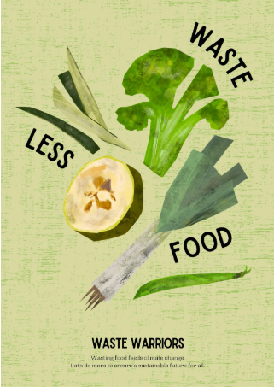
Sustainable Consumption
The concept of consuming goods and services in a way that minimizes environmental impact and promotes social equity.
Discussion on reducing waste, promoting circular economy models, conscious consumerism, and the role of businesses in offering sustainable products.
Recent Research: Consumer behavior, the impact of sustainable products, and the effectiveness of initiatives like eco-labeling.

Slide 75
Ali, M., Ullah, S., Ahmad, M. S., Cheok, M. Y., & Alenezi, H. (2023). Assessing the impact of green consumption behavior and green purchase intention among millennials toward sustainable environment. Environmental Science and Pollution Research, 30(9), 23335-23347.

Slide 76
Aspect | Description
Introduction /Pain Point | Increasing carbon emissions and environmental damage due to non-organic consumption patterns. Need for a shift towards sustainable consumption behaviors, particularly among millennials.
Gap in Knowledge | Limited understanding of how social media influences green consumption behavior and purchase intentions among millennials. Need to explore the interplay of factors like eco-labeling, eco-branding, and social norms in this context.
Objectives | To investigate the impact of social media on green consumption behavior and green purchase intention among millennials. To examine the mediating role of eco-labeling, eco-branding, and social norms in this relationship.
Research Questions | - How does social media influence millennials' green consumption behavior? <br> - How does social media affect millennials' green purchase intention? <br> - What is the role of eco-labeling, eco-branding, and social norms in this process?

Slide 77
Aspect | Description
Methodology | Cross-sectional questionnaire survey of millennial students from different faculties (social sciences, engineering, and bio-sciences). Data analysis using SPSS and Smart-PLS (statistical software).
Findings | Social media has a significant positive impact on millennials' green consumption behavior and green purchase intention. Eco-labeling, eco-branding, and social norms play a mediating role in this relationship.
Discussion | The findings highlight the importance of social media in promoting sustainable consumption. Eco-conscious marketing strategies and social influence can encourage green consumption among millennials. The study contributes to the growing body of literature on sustainable consumption and the role of social media.
Recommendations | Businesses should leverage social media to promote green products and practices. Policymakers should encourage the use of eco-labeling and support initiatives that foster social norms around sustainable consumption. Further research should explore the long-term impact of social media on green consumption and investigate other factors that may influence sustainable behavior.

Slide 78
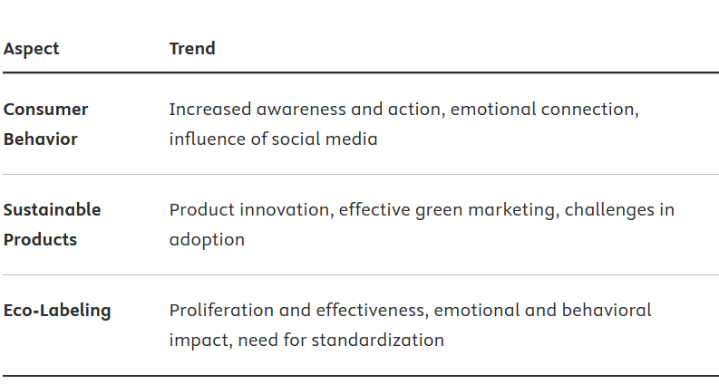

Slide 79
Reference
Ali, M., Ullah, S., Ahmad, M. S., Cheok, M. Y., & Alenezi, H. (2023). Assessing the impact of green consumption behavior and green purchase intention among millennials toward sustainable environment [Article]. Environmental Science and Pollution Research, 30(9), 23335-23347. https://doi.org/10.1007/s11356-022-23811-1
Baier, D., Rausch, T. M., & Wagner, T. F. (2020). The drivers of sustainable apparel and sportswear consumption: A segmented kano perspective [Article]. Sustainability (Switzerland), 12(7), Article 2788. https://doi.org/10.3390/su12072788
Barkemeyer, R., Young, C. W., Chintakayala, P. K., & Owen, A. (2023). Eco-labels, conspicuous conservation and moral licensing: An indirect behavioural rebound effect [Article]. Ecological Economics, 204, Article 107649. https://doi.org/10.1016/j.ecolecon.2022.107649
Ghouse, S. M., Shekhar, R., Ali Sulaiman, M. A. B., & Azam, A. (2024). Green purchase behaviour of Arab millennials towards eco-friendly products: the moderating role of eco-labelling [Article]. Bottom Line. https://doi.org/10.1108/BL-08-2023-0246
Gomes, K. C., Nora, G. A. M., Andrade, C. R. D., Alberton, A., & Lyra, F. R. (2022). Environmental Label Features and their Theoretical Implications for Sustainability Market Practices towards a Circular Economy [Article]. Revista Interdisciplinar de Ciencia Aplicada, 6(11), 60-72. https://doi.org/10.18226/25253824.v6.n11.08
Gutierrez, A. M. J., Chiu, A. S. F., & Seva, R. (2020). A proposed framework on the affective design of eco-product labels [Article]. Sustainability (Switzerland), 12(8), Article 3234. https://doi.org/10.3390/SU12083234
Hael, M., Hazaea, S. A., Zhang, H., & Mareeh, H. (2024). Mapping the literature trends of consumer behavior and sustainability: insights from a bibliometric analysis approach [Review]. Environment, Development and Sustainability. https://doi.org/10.1007/s10668-023-04382-8
Horne, R. E. (2009). Limits to labels: The role of eco-labels in the assessment of product sustainability and routes to sustainable consumption [Article]. International Journal of Consumer Studies, 33(2), 175-182. https://doi.org/10.1111/j.1470-6431.2009.00752.x
Majeed, M. U., Aslam, S., Murtaza, S. A., Attila, S., & Molnár, E. (2022). Green Marketing Approaches and Their Impact on Green Purchase Intentions: Mediating Role of Green Brand Image and Consumer Beliefs towards the Environment [Article]. Sustainability (Switzerland), 14(18), Article 11703. https://doi.org/10.3390/su141811703
Zhang, Z., Sami, F., Ullah, I., Khan, S. U., & Khan, S. (2024). Analyzing the green marketing approaches and their impact on consumer behavior toward the environment in China: a logistic regression approach [Article]. Environment, Development and Sustainability, 26(11), 29453-29474. https://doi.org/10.1007/s10668-023-03985-5

Slide 80
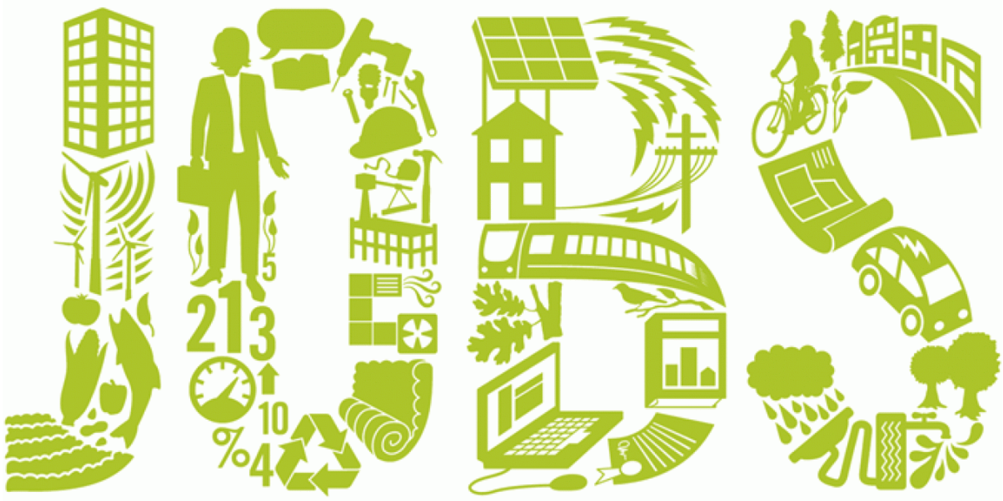
Green Jobs
Roles that contribute to preserving or restoring the environment
The projected growth of the green job market and its potential to drive sustainable economic development.
Recent Research: Include findings on the economic benefits of green jobs, skills gaps, and the role of education and training.

Slide 81
Aspect | Key Points
Green Jobs | Green jobs are essential across various sectors including agriculture, manufacturing, building, transport, tourism, and renewable energy. They contribute to reducing negative environmental impacts and support sustainable development. The transition to green jobs is crucial for mitigating climate change and fostering economic growth.
Skills Gaps | There is a significant skills gap in the workforce for green jobs, which poses challenges for businesses and governments. Green jobs require higher levels of creative problem-solving, nonroutine activities, formal education, and on-the-job training compared to traditional jobs. The skill gap between green energy and fossil fuel workers is modest, but green jobs require significantly more training.
Role of Education and Training | Education and training systems need to adapt to provide the necessary green skills. Training should include both technical and soft skills to enable successful completion of environmentally responsible tasks. There is a need for increased access to education in sustainability to prepare individuals for green jobs. Vocational education and training (TVET) providers play a crucial role in equipping the workforce with green skills. Firms must also take responsibility for developing green skills among their employees through various HR practices.
Policy and Strategic Recommendations | Governments should prioritize skills needed for a low carbon transition and integrate green skills into the skills delivery system. Macro-economic policies should aim at full employment and include green jobs as a priority direction. International and national policies should support the development of green skills and jobs to address economic and ecological crises.

Slide 82
Reference
Boone, C. G., Bromaghim, E., & Kapuscinski, A. R. (2023). Sustainability Careers [Review]. Annual Review of Environment and Resources, 48, 589-613. https://doi.org/10.1146/annurev-environ-120920-105353
Bukhvald, E. M., Chernykh, A. A., & Pochkin, E. O. (2022). Skills Development in a Green Economy. Lecture Notes in Networks and Systems,
Irmatova, A., Iskandarova, D., Pirnazarova, G., Mansurov, J., & Xakimova, M. (2024). Green Jobs in a Sustainable Labor Market: Remote Work, Skills and Training. E3S Web of Conferences 574, 07002 (2024).
Maclean, R., Jagannathan, S., & Panth, B. (2018). Introduction. In Technical and Vocational Education and Training (Vol. 27, pp. 19-40). https://doi.org/10.1007/978-981-10-6559-0_2
Maclean, R., Jagannathan, S., & Panth, B. (2018). Overview. In Technical and Vocational Education and Training (Vol. 27, pp. 1-18). https://doi.org/10.1007/978-981-10-6559-0_1
Maniatis, P. (2024). Quality education in the field of sustainability using a statistical analysis [Article]. Sustainable Development, 32(5), 4977-4991. https://doi.org/10.1002/sd.2931
Napathorn, C. (2022). The development of green skills across firms in the institutional context of Thailand [Article]. Asia-Pacific Journal of Business Administration, 14(4), 539-572. https://doi.org/10.1108/APJBA-10-2020-0370
Popp, D., Marin, G., Vona, F., & Chen, Z. (2021). The Employment Impact of a Green Fiscal Push: Evidence from the American Recovery and Reinvestment Act [Article]. Brookings Papers on Economic Activity, 2021-Fall, 1-69. https://doi.org/10.1353/eca.2022.0000
Rakauskiene, O. G., & Okuneviciute-Neverauskiene, L. (2015). Strategic guidelines of increasing employment and reducing unemployment in the context of EU (Lithuanian case) [Article]. Transformations in Business and Economics, 14(2), 224-253. https://www.scopus.com/inward/record.uri?eid=2-s2.0-84931053878&partnerID=40&md5=15998a3d0d203d6b20f689d4521d4a47
Valenti, A., Gagliardi, D., Fortuna, G., & Iavicoli, S. (2016). Towards a greener labour market: Occupational health and safety implications [Article]. Annali dell'Istituto Superiore di Sanita, 52(3), 415-423. https://doi.org/10.4415/ANN_16_03_13

Slide 83
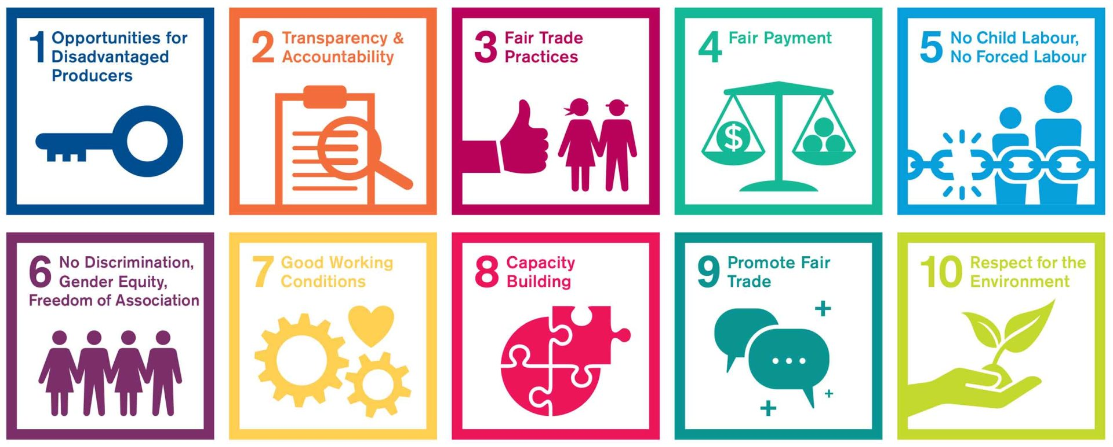
Fair Trade
The core principles of fair trade
How fair trade empowers marginalized producers, particularly in developing countries
The role of consumers in supporting fair trade through their purchasing decisions
Recent Research: The impact of fair trade on producers' livelihoods, community development, and environmental sustainability

Slide 84
Aspect | Key Points
Producers' Livelihoods | Stable Prices and Market Access: Fair Trade provides better access to market outlets and stable prices, which are crucial for sustainable poverty reduction and improving producers' livelihoods. Income and Wealth: Fair Trade initiatives have shown positive impacts on income, consumption, and wealth of producers, contributing to their economic stability. Empowerment: Fair Trade fosters the wellbeing and empowerment of producers by providing higher prices, better working conditions, and community development resources.
Community Development | Institutional Development: Fair Trade supports the development of sustainable commercial organizations and strengthens producer organizations, which are essential for community development. Social Development: Fair Trade initiatives contribute to social development, including improvements in education, healthcare, and infrastructure within communities. Gender Equity: Although Fair Trade aims to promote gender equity, there is less success in achieving this goal, indicating a need for continuous commitment and strategies.
Environmental Sustainability | Sustainable Farming Practices: Fair Trade influences farming practices that contribute to environmental conservation, even if it does not directly impact natural. Resource Management: Fair Trade certification can work as an approach for natural resource management, linking environmental conservation with poverty reduction. Water Productivity: Fair Trade premiums ensure the remuneration of virtual water used in the production of crops, highlighting its role in environmental sustainability.

Slide 85
Bohnenberger, K. (2022). Greening work: labor market policies for the environment. Empirica, 49(2), 347-368.

Slide 86
Category | Description
Introduction/Pain Point | Jobs are crucial for social inclusion, tax revenue, and the financial stability of welfare states. There's a growing need to "green" economies and labor markets to meet sustainability goals (SDGs, Paris Agreement, European Green Deal). Traditional labor market policies often don't consider environmental impacts. This paper analyzed how eight different labor market strategies contribute to the greening of employment.
Gap in Knowledge | Limited understanding of how labor market policies can contribute to greening employment and achieving a just transition to a sustainable economy.
Objectives | To assess how labor market policies can be used to green employment. To analyze the potential effects of different policy strategies on creating more sustainable employment.
Research Questions | How can labor market policies contribute to greening employment? What are the potential effects of different labor market policy strategies on different dimensions of sustainable employment?

Slide 87
Category | Description
Methodology | Literature review and conceptual analysis of eight labor market policy strategies
Findings | All eight strategies have the potential to green employment, but to varying degrees across the four dimensions of sustainable employment. Conversion of plants and businesses and environmental decommodification are most effective in greening the output type. Environmental labor law, vocational guidance and training, and alternative income sources are most effective in improving the tasks and activities of occupations. Distribution of employment time and a socio-ecological job guarantee can make processes more resource- and energy-efficient.
Discussion | The findings highlight the need for a broader set of labor market policies to achieve a green and just transition. The "Taxonomy of Sustainable Employment" framework provides a useful tool for analyzing and comparing the effects of different policies.
Recommendations | Policymakers should consider a wider range of labor market policies to green employment. Further research is needed to assess the specific impacts of different policy combinations and their implementation challenges.

Slide 88
Conclusion
Interconnections: Emphasize how sustainable consumption, green jobs, and fair trade are interconnected and crucial for a sustainable economy.
Call to Action: Encourage students to consider their roles as consumers, future professionals, and citizens in promoting economic sustainability.
Resources: Provide links to organizations, research papers, and initiatives related to the topics discussed.

Slide 89
Q&A

Slide 90
Thank you

